Slide 1
An NSS Audio-Visual
Library Presentation
Exploration of the Sumidero of Rio San Jose Atima, Honduras
Steve Knutson, June 1989
S741 57 Slides 2/10/2021

Slide 2
Notes:
The Rio Atima effort is a prime example of small party expeditions going up against a very technically difficult, hazardous cave. Even though Atima's upper and lower entrances are separated by only 2.5 kilometers of cave passage and are only 190 meters apart in elevation, it took more than a kilometer of rope, distributed over 54 riggings to explore the cave. Natural anchors were scarce and as a result numerous bolts and pitons had to be placed in order to proceed. The ever-present river was flowing at 30 to 50 cubic feet per second over rapids and waterfalls. It created a series of significant obstacles requiring bypass climbs and rappels. The Choreadero in Chiapas, Mexico was described by a British expedition as "perhaps the most sporting through-trip cave in the world". But it is a "bop" compared to Atima.

Slide 3
Notes:
Exploration of the Sumidero of Rio San Jose de Atima began with a 1981 expedition by Jon Burkig, Steve Knutson, and Todd Rasmussen.

Slide 4
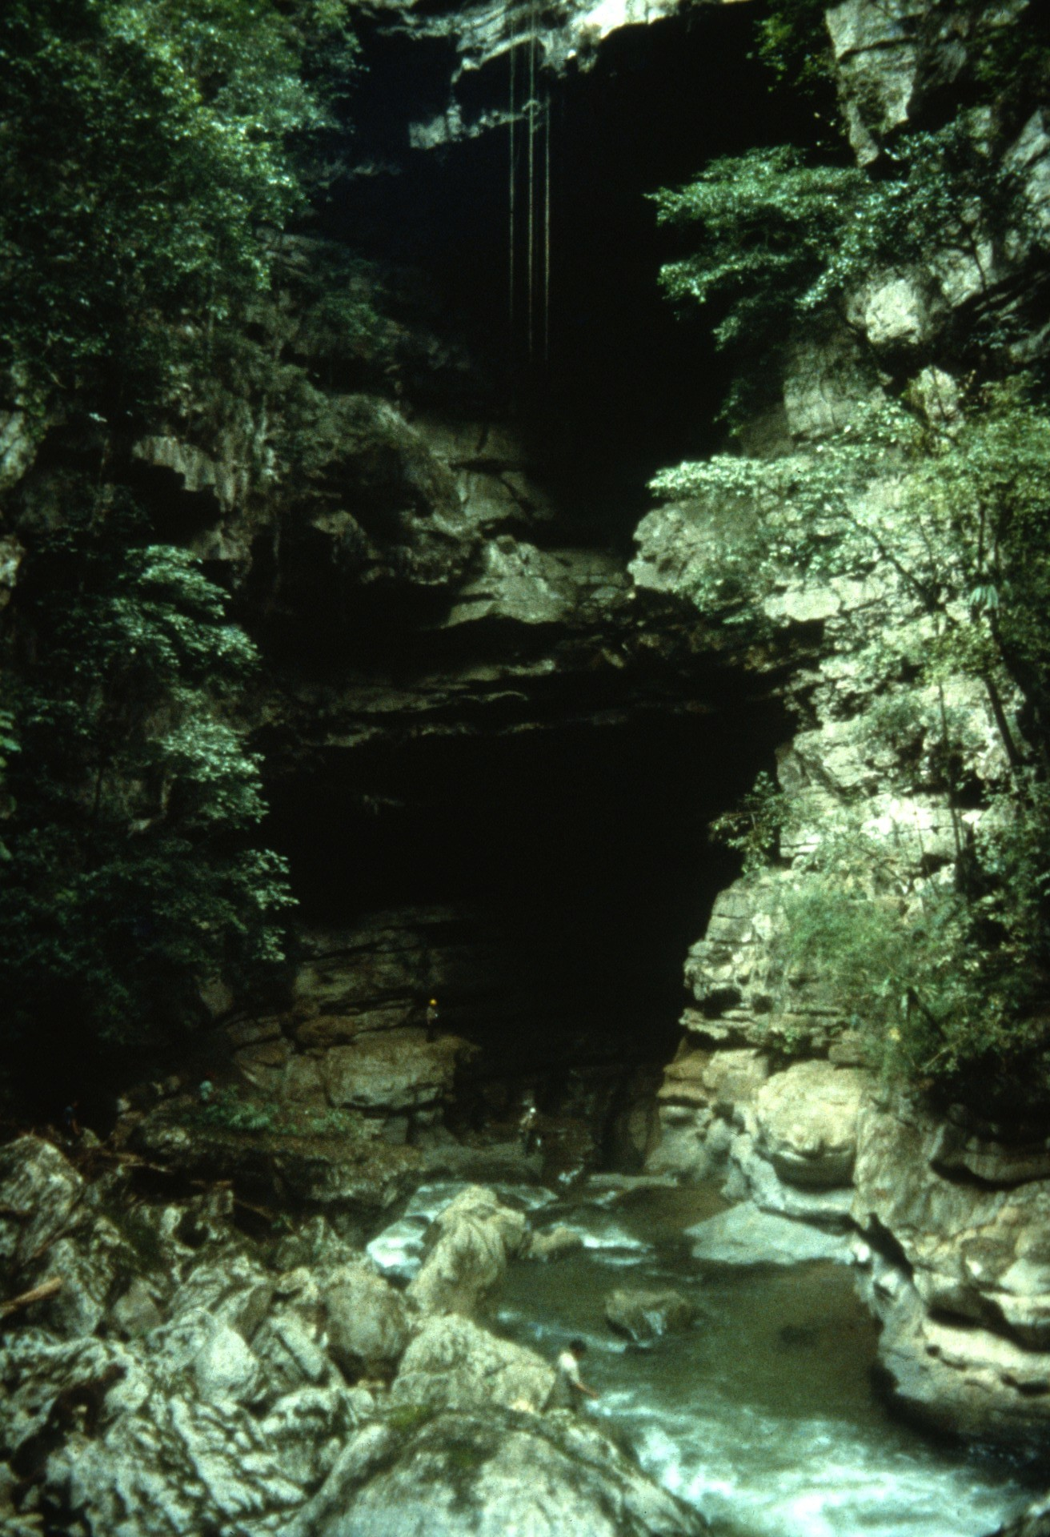
Notes:
With the water flow up from a recent storm, they entered Atima's upstream entrance…

Slide 5
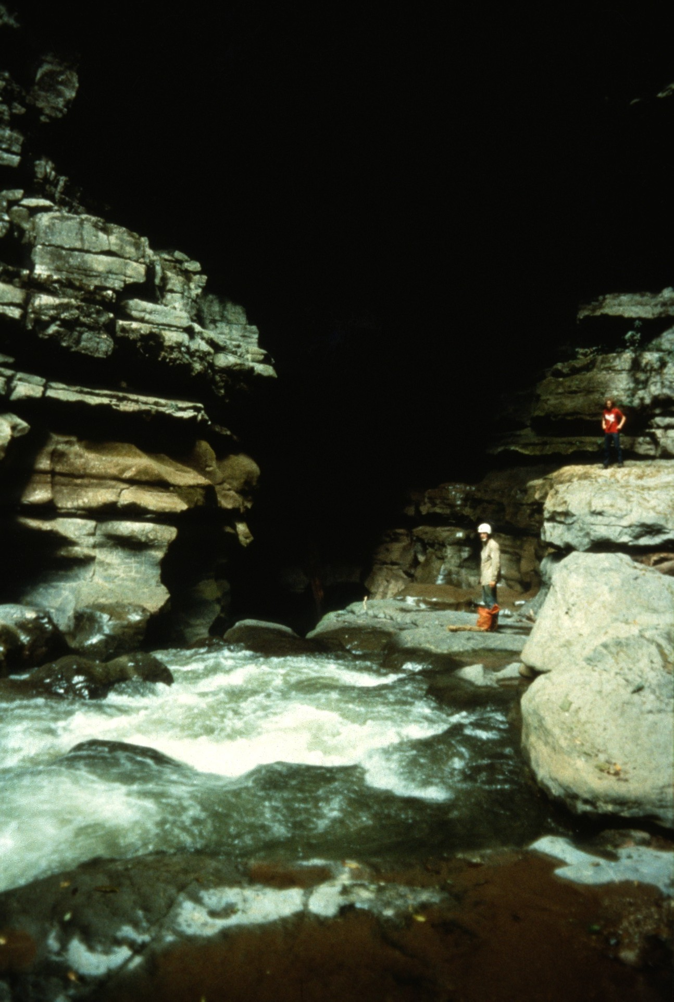
Notes:
…waterfalls. Not far inside was the first of many waterfalls.

Slide 6
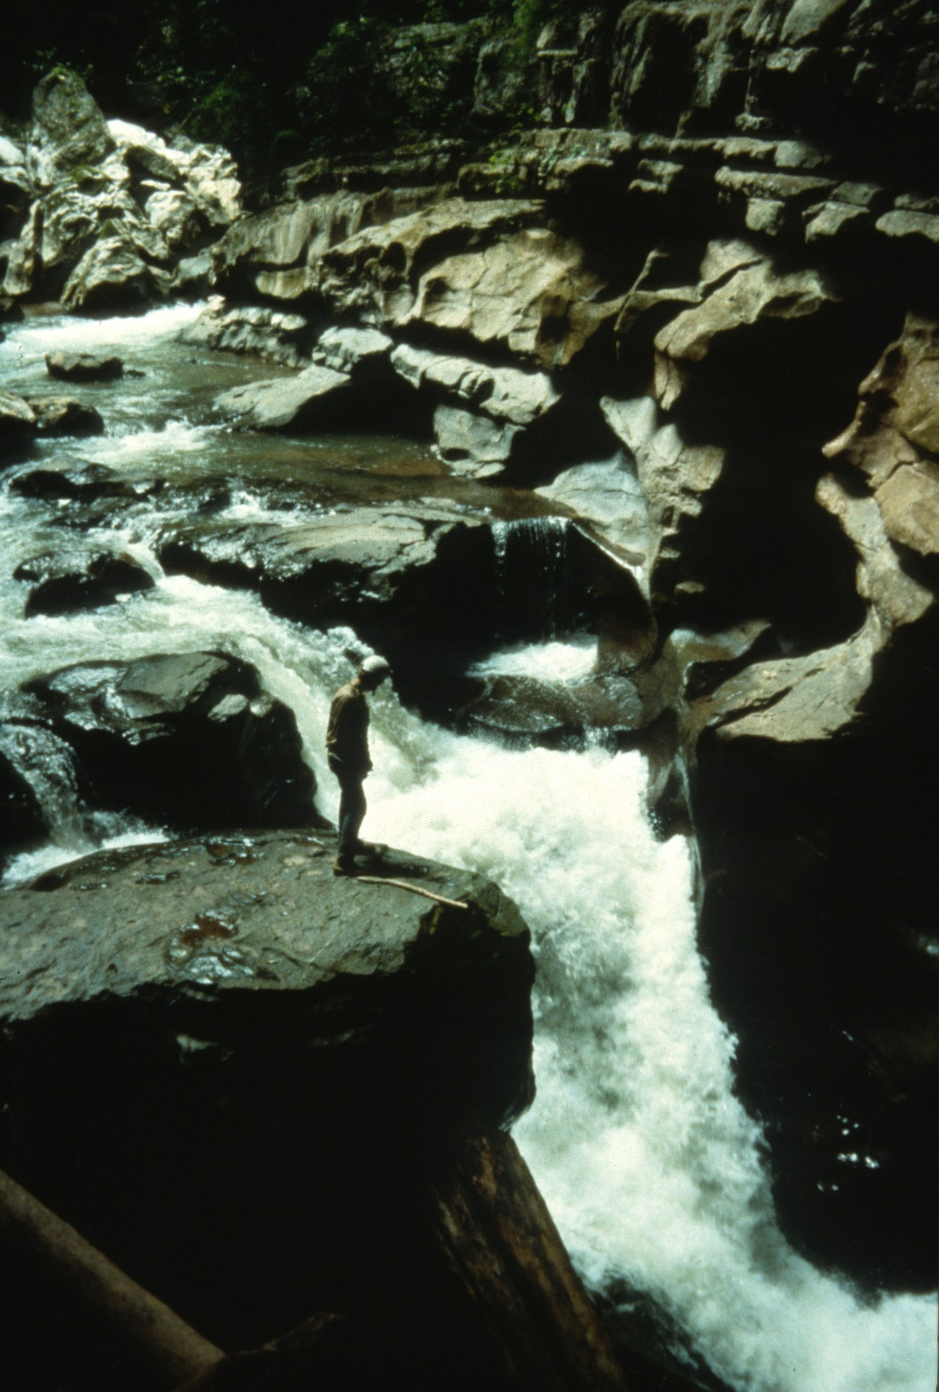
Notes:
(more waterfalls)

Slide 7
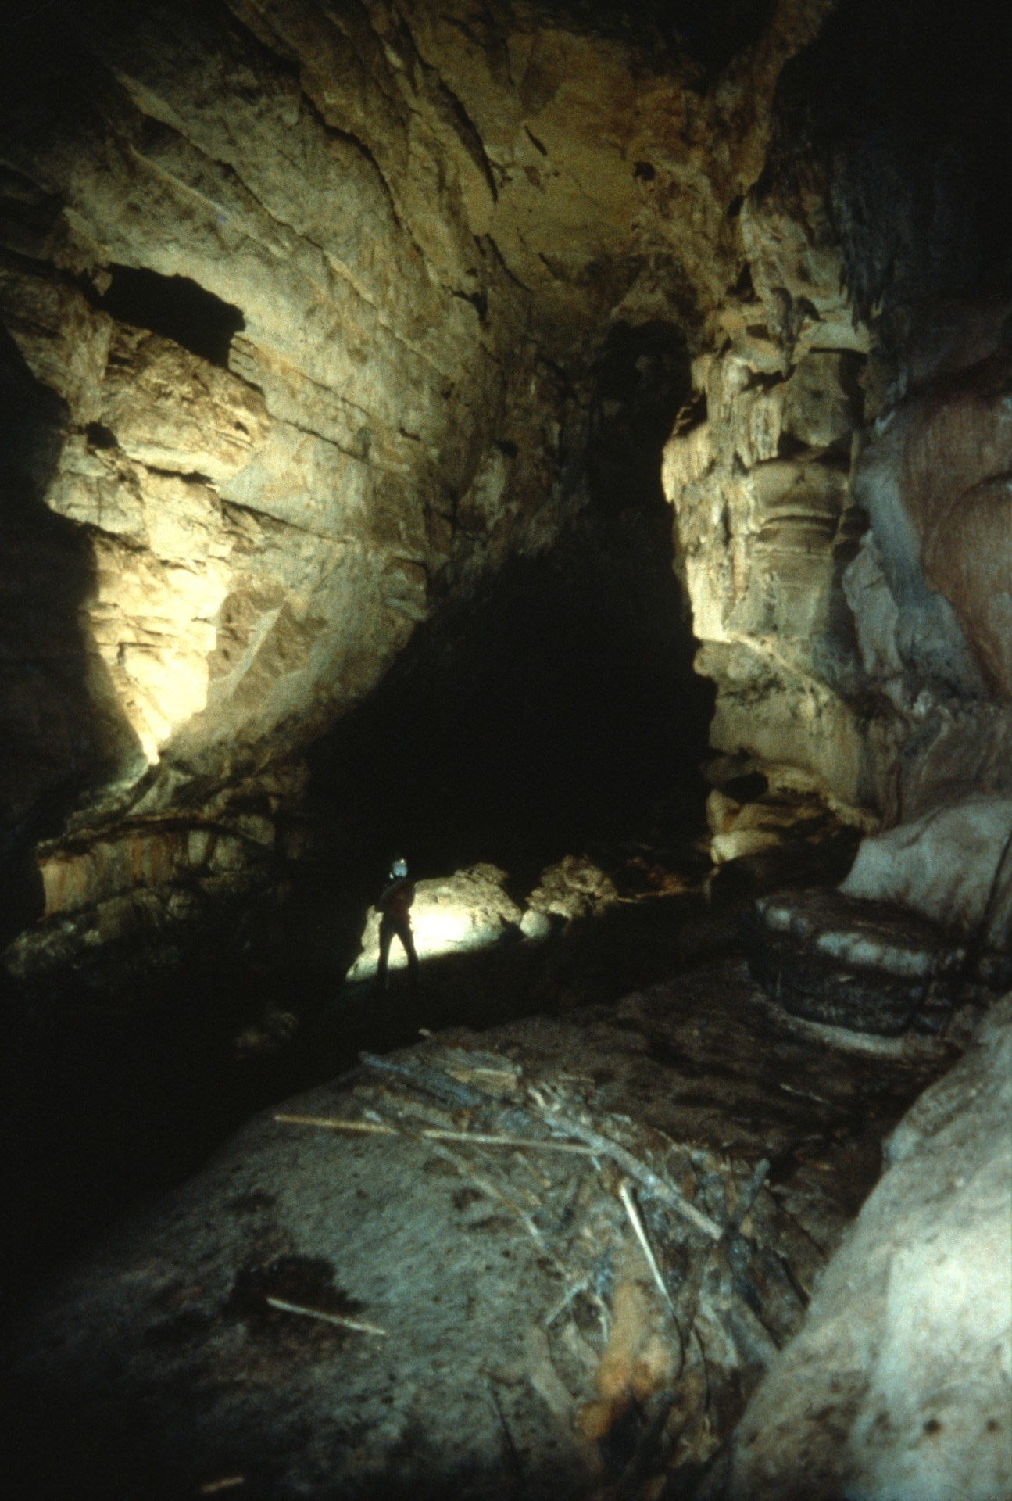
Notes:
They were able to go 500 meters into the cave by moving along ledges on the left wall. Along the way were numerous short rappels, up-climbs, and hand line traverses. For the last 200 meters, the ledges were quite narrow and tricky, slick and wet from the spray of the rapids below. Note the flood debris.

Slide 8
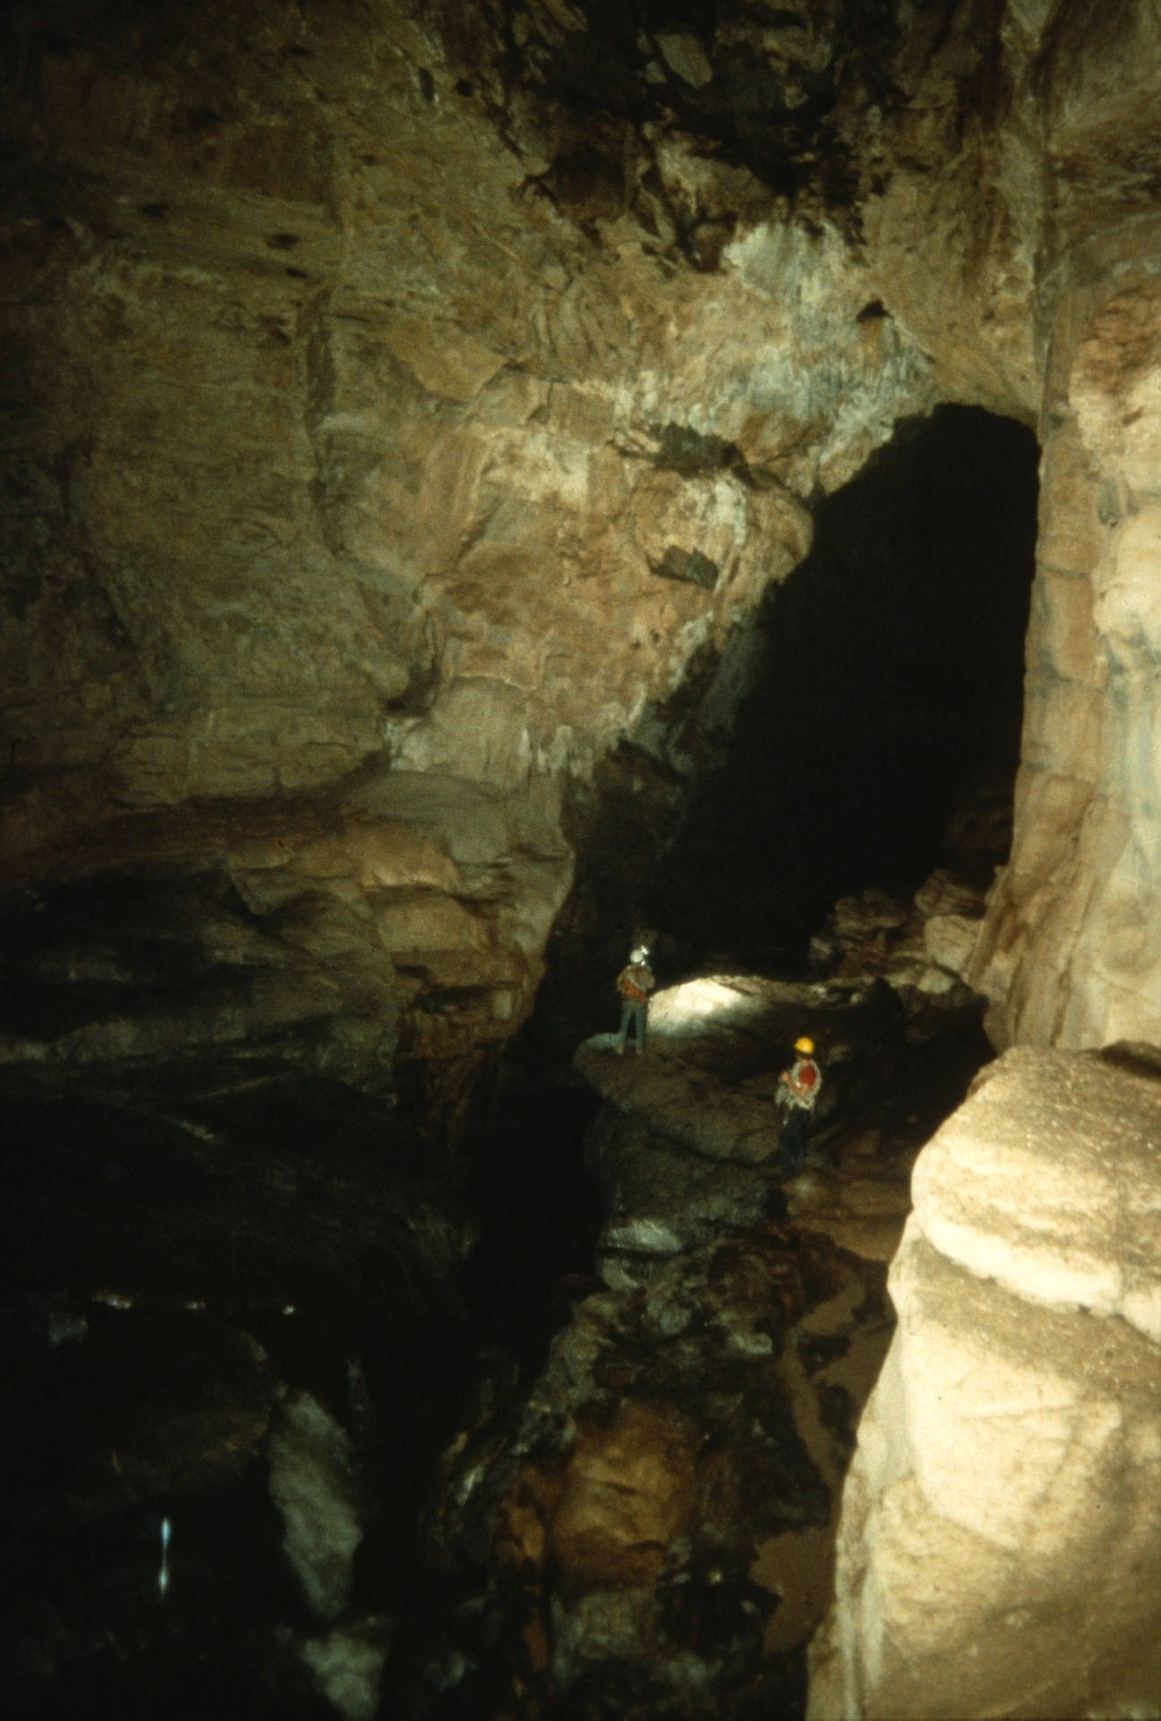
Notes:
With a drainage basin of 125 square kilometers, there was always a danger that the cave would flood.

Slide 9
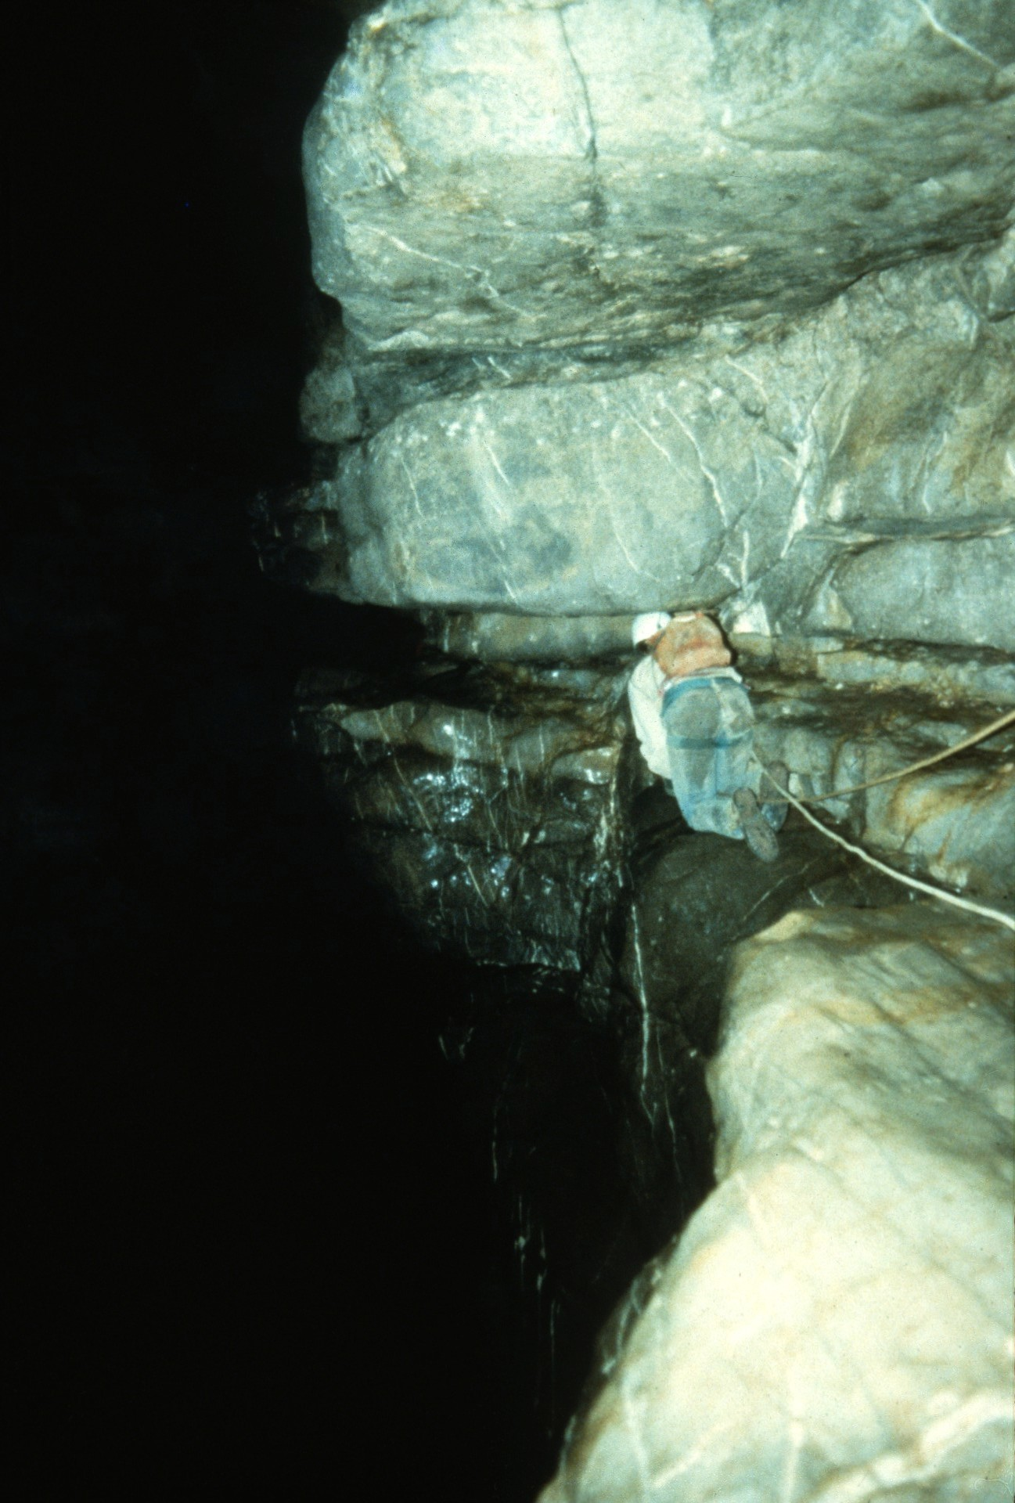
Notes:
At the end of the 1981 expedition the team reached the end of the ledges. Here Jon Burkig crawls across a narrow ledge, with the river raging 12 meters below.

Slide 10
Notes:
The next expedition did not come until 1985 when Steve Knutson, Pete Shifflett, and Mark Stock entered Atima's upstream entrance to continue the exploration and survey of the cave.

Slide 11
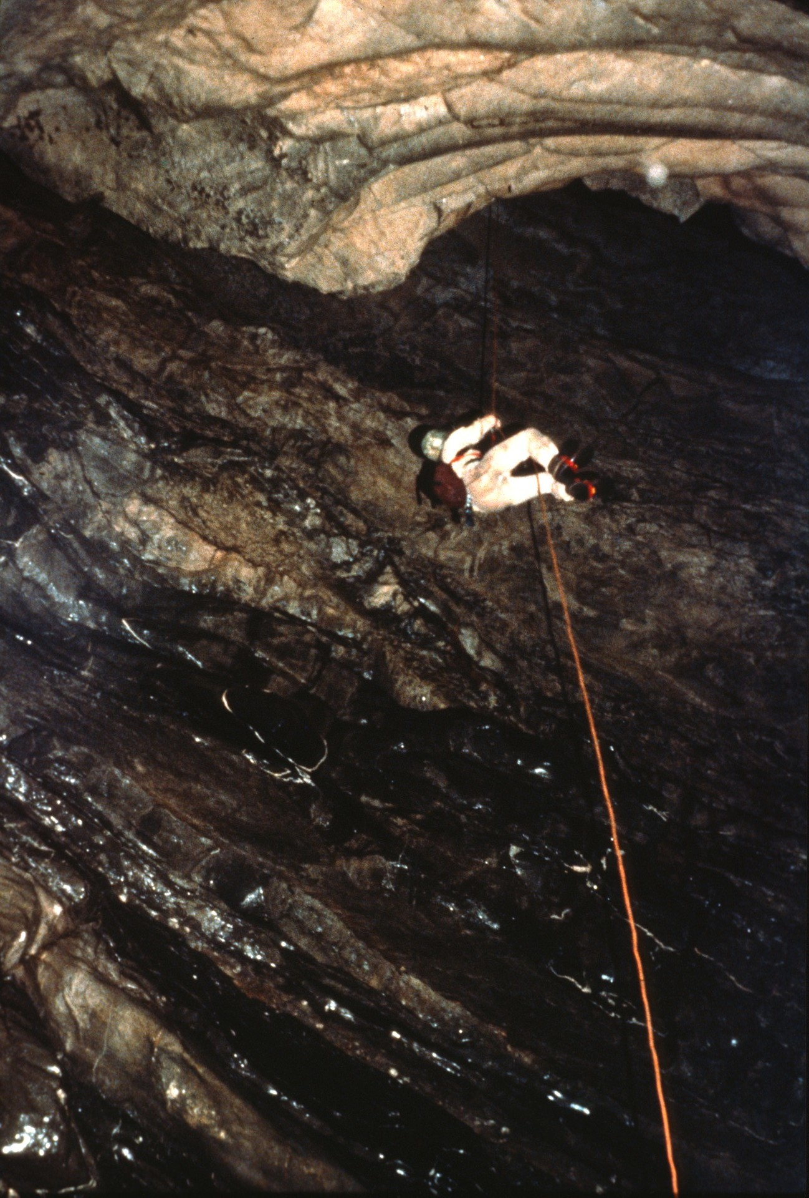
Notes:
At the end of the ledges, they descended to river level...

Slide 12
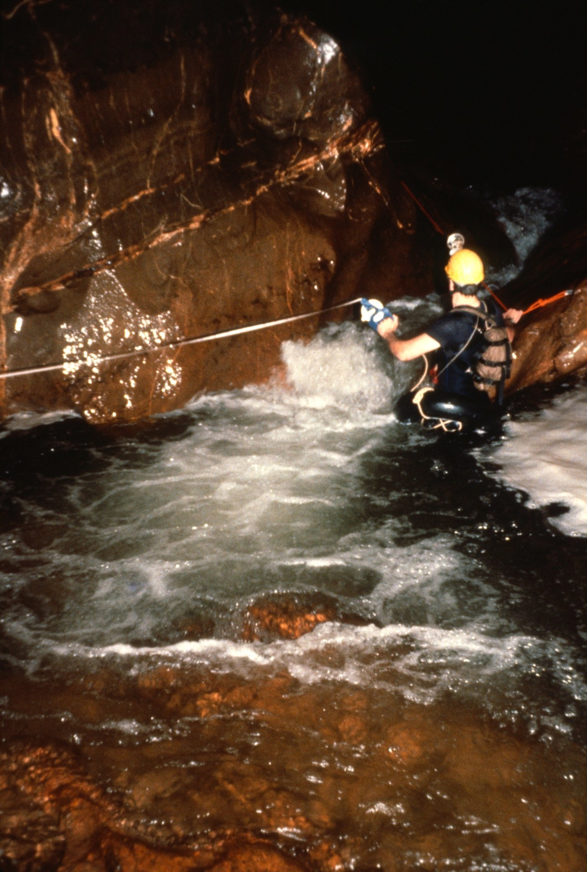
Notes:
…and continued the survey.

Slide 13
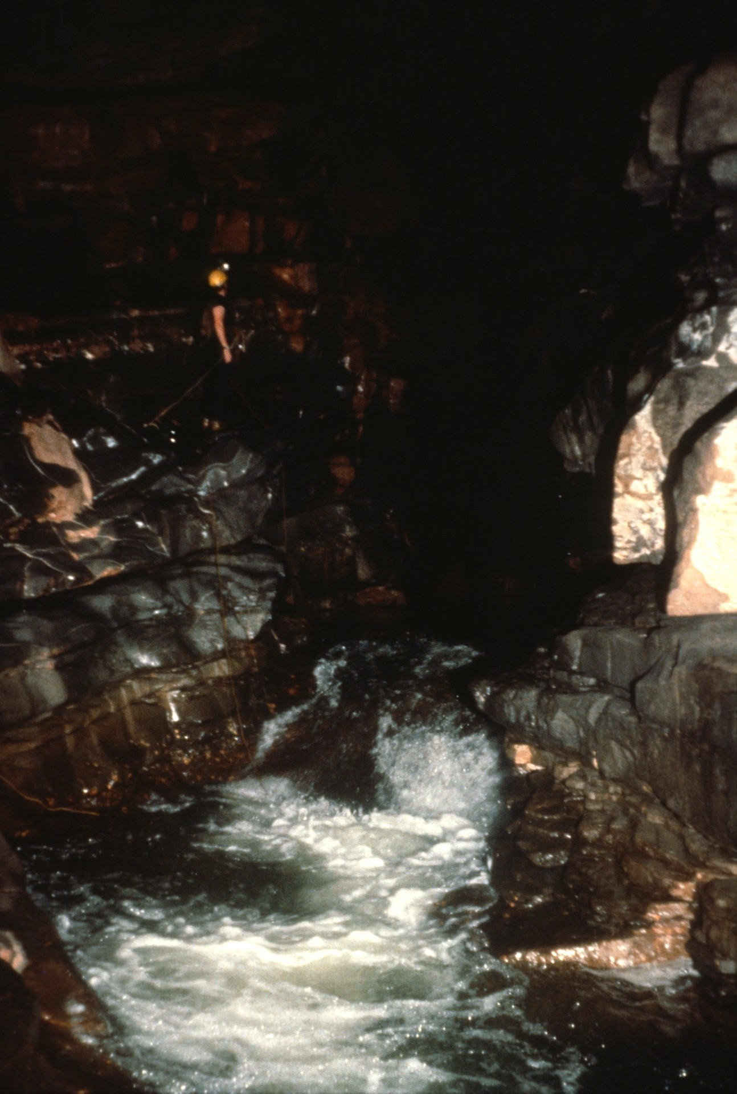
Notes:
Short waterfalls were common.

Slide 14
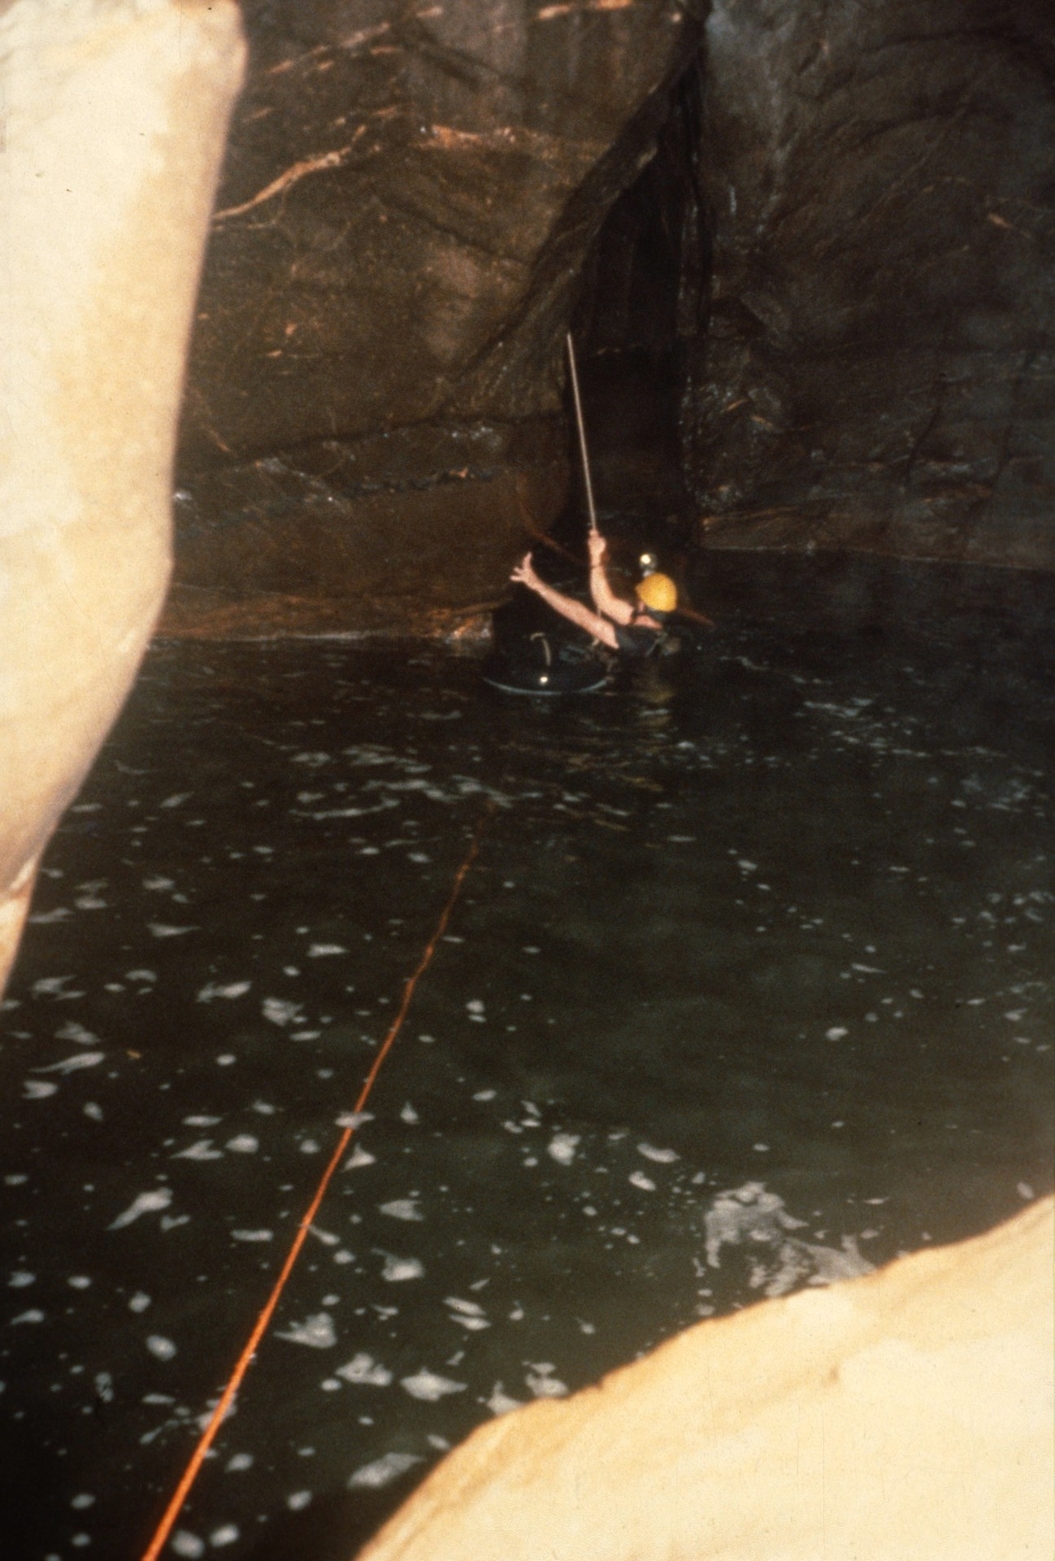
Notes:
Mark Stock nears the bottom of a 40 foot rappel, bypassing a 4 meter waterfall. Red polypropylene canal line trails down the current. Considerable hardware and rope was required to by-pass each falls or rapids.

Slide 15
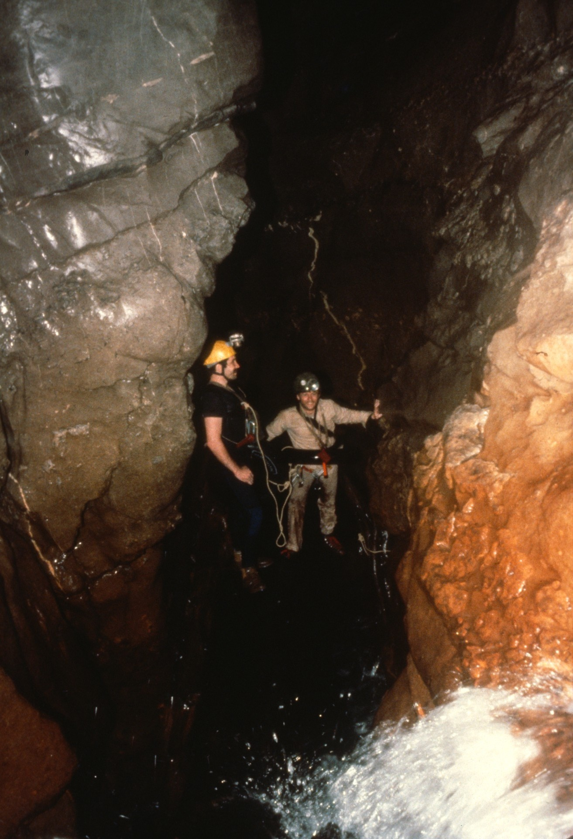
Notes:
Mark Stock and Pete Shifflett stand on a log that slopes down a waterfall from top to bottom providing an easy route to below. The following year it was gone. Every log in the canyon changed position from year to year.

Slide 16
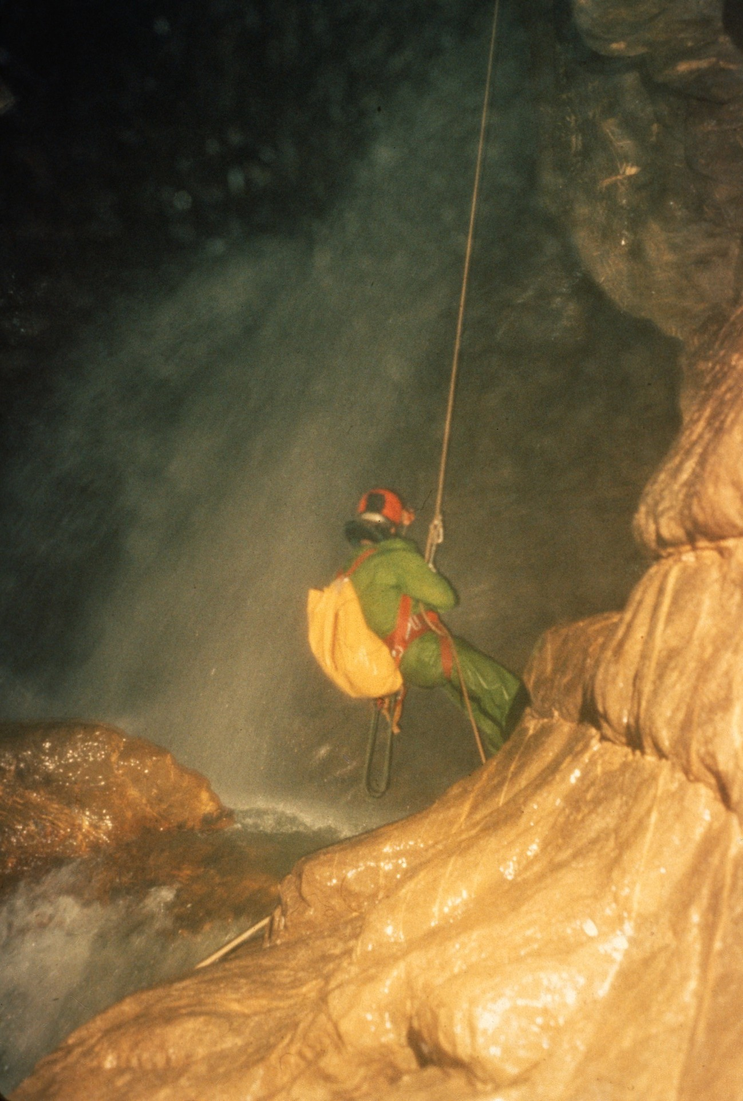
Notes:
About 300 meters further downstream they met their first major obstacle, a 10-meter waterfall. In 1985, one trip into the cave was devoted just to getting by it. Steve Knutson climbed 10 meters up the right wall to a ledge high above the falls in order to get out far enough to allow a rappel that stayed out of the plunge of the falls. John Wyeth is shown at the bottom of the rappel next to the base of the waterfall. Note the sloping ledge. It led for 20 meters along a fast water chute to a wider pool with slow water beyond.

Slide 17
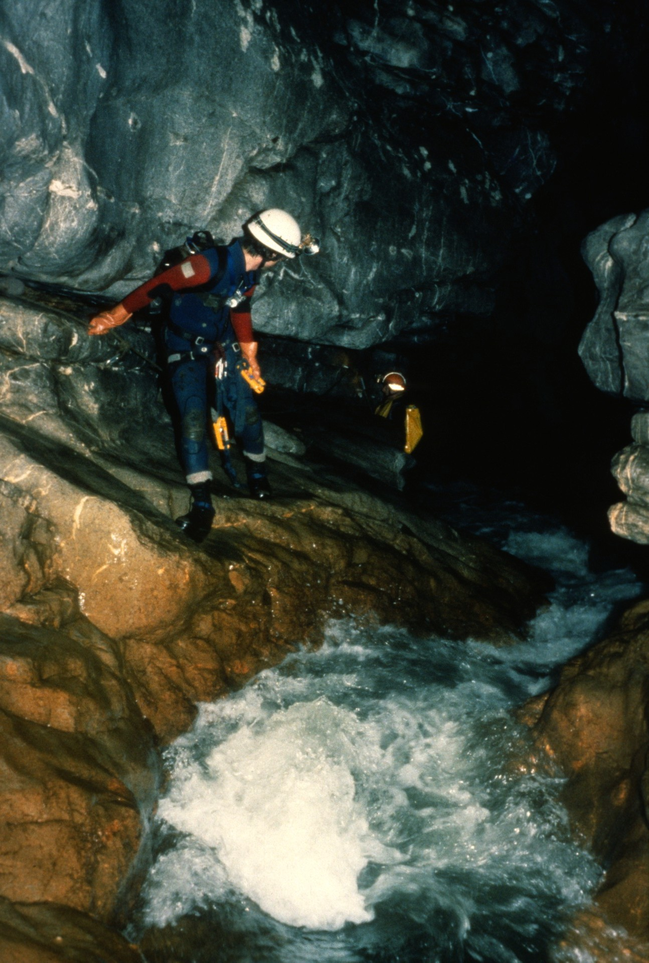
Notes:
Scott Linn and John Blum traversing the ledge.

Slide 18
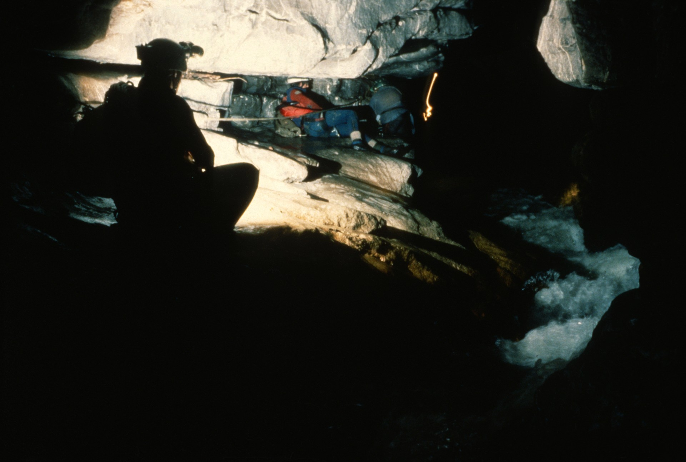
Notes:
(Scott Linn and John Blum traversing the ledge.)

Slide 19
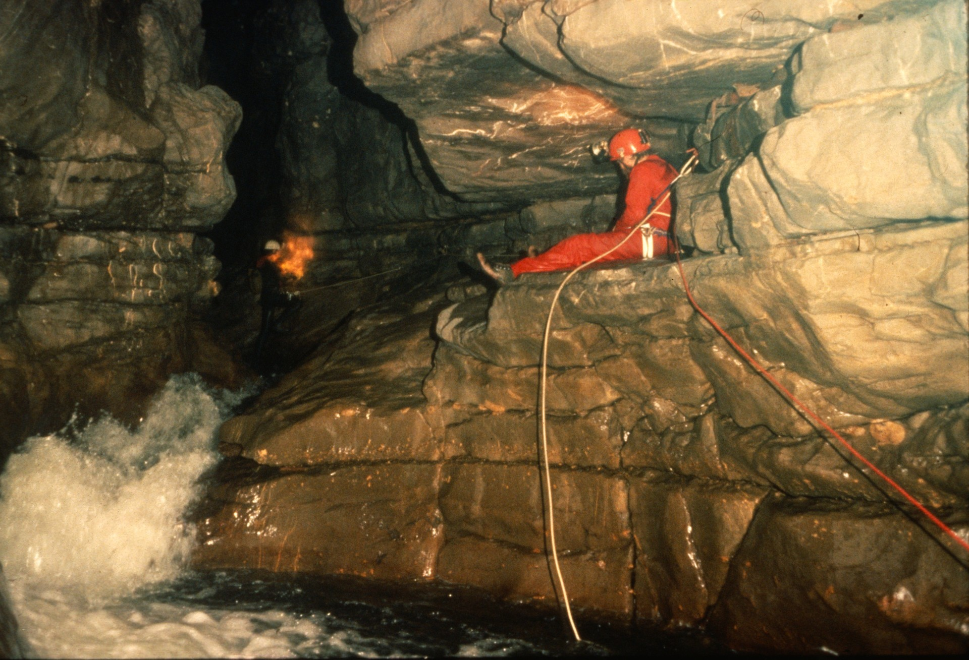
Notes:
A view of the ledge from below, showing Pete Carter sitting at the end of the ledge while Randy Spahl traverses toward him. This marked the end of the 1985 expedition as they ran short of gear. Before departing they took a trip around the mountain to Atima's lower entrance and found the lower section of the cave was less technically challenging. They were able to penetrate nearly a kilometer into the lower cave leaving a gap of only 400 to 500 meters straight line distance between the two cave surveys.

Slide 20
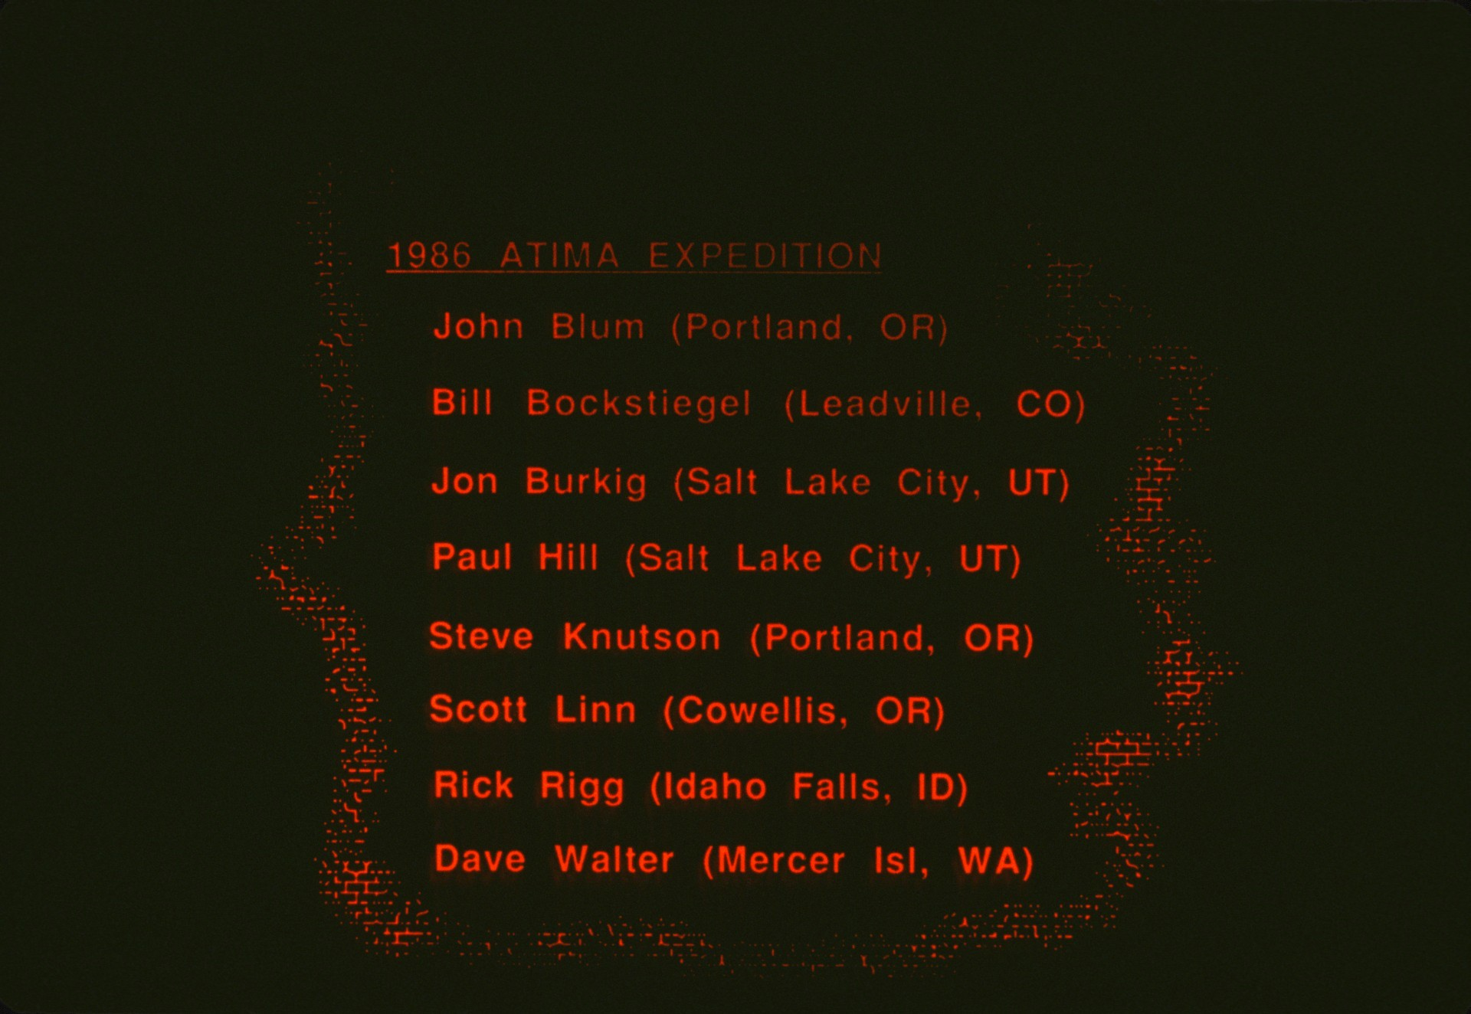
Notes:
Then in 1986 John Blum, Jon Burkig, Paul Hill, Steve Knutson, Scott Linn, Rick Rigg, Bill Bockstiegel, and Dave Walker returned to continue the survey. While the expedition started with more cavers than ever, Scott Linn and John Blum were only able to have one productive cave trip due to sickness, and Rick Rigg had none.

Slide 21
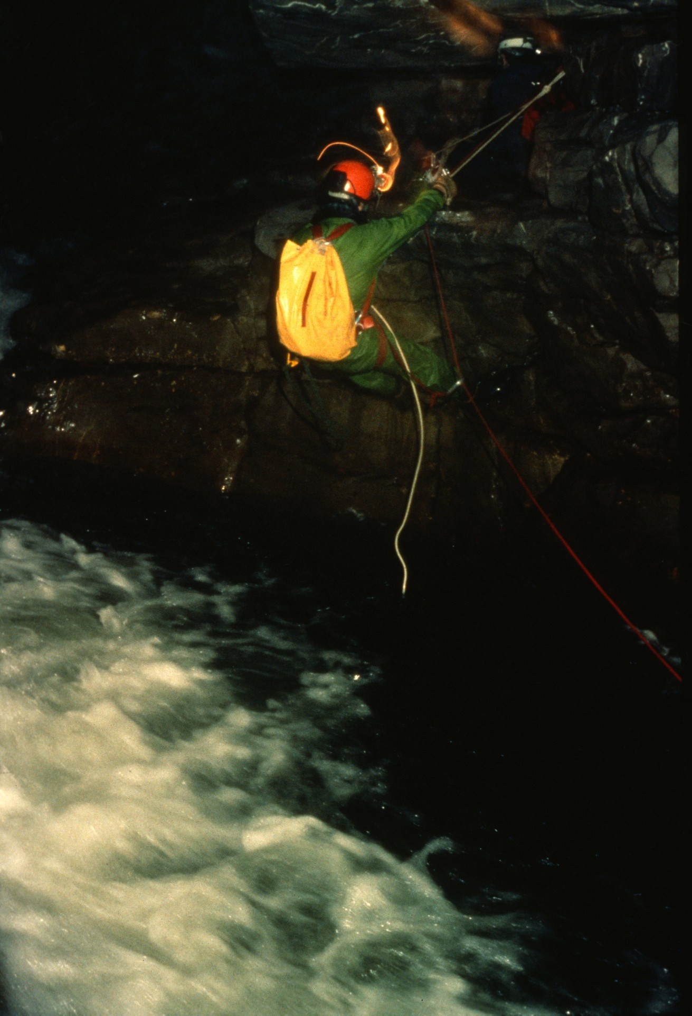
Notes:
Returning to the end of the ledge, they rappelled into the water chute below.

Slide 22
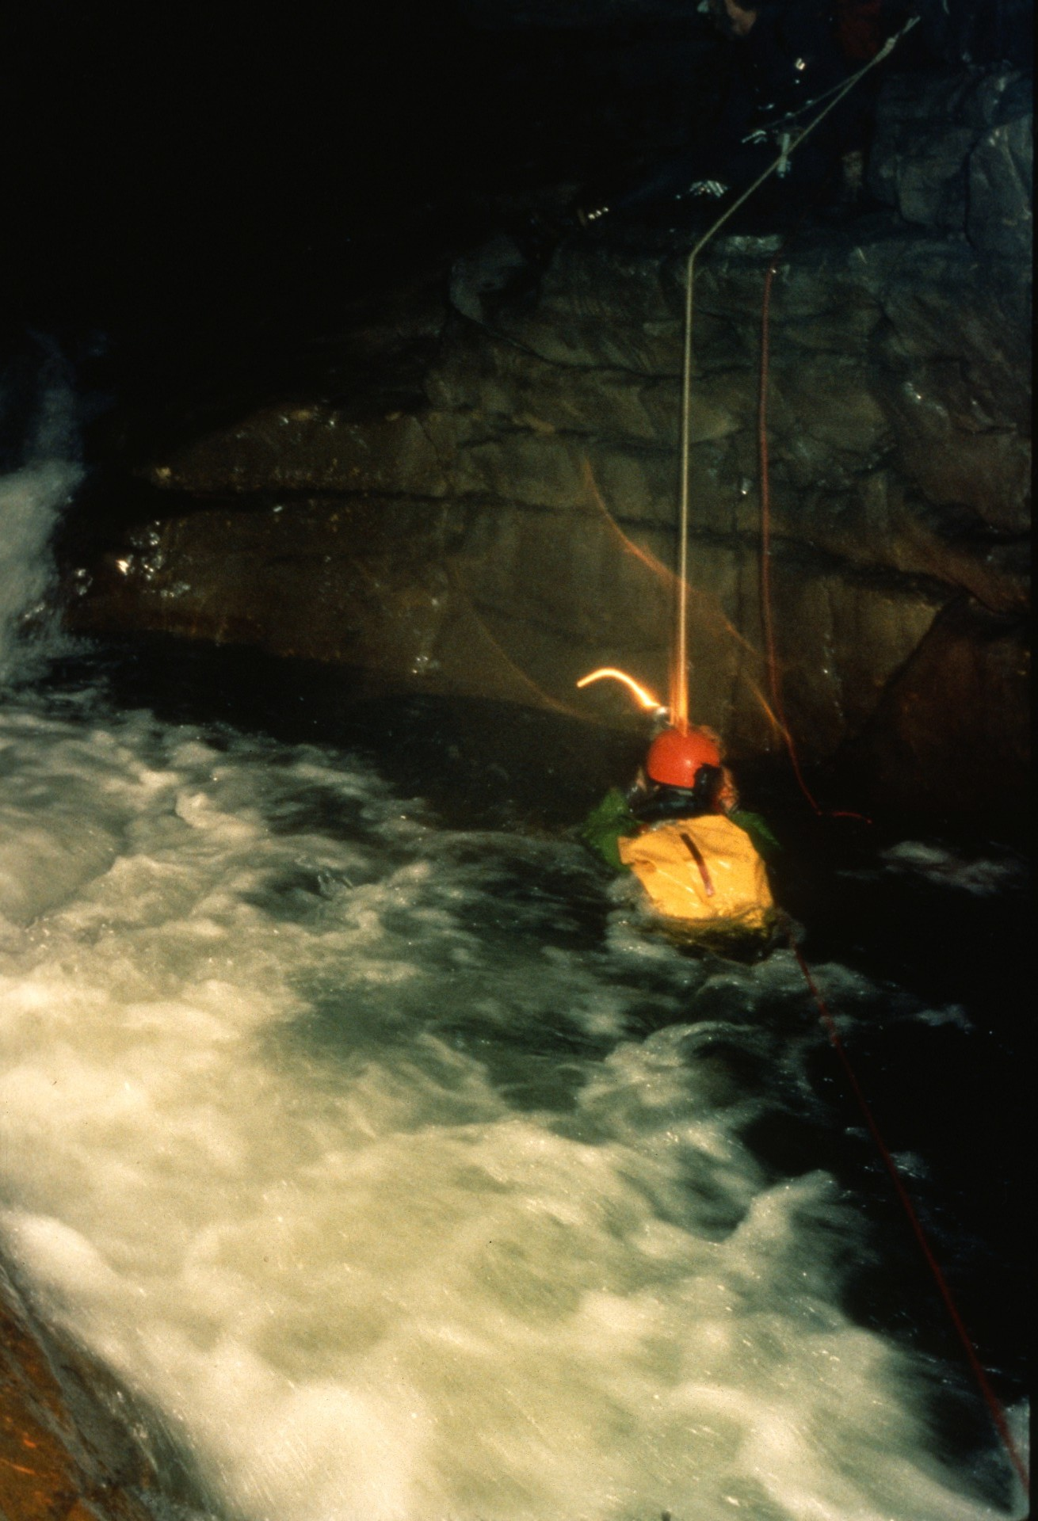
Notes:
Scott Linn and Jon Burkig found that without a canal line they were temporarily sucked underwater by the eddy currents. Later a canal line was installed to avoid this problem.

Slide 23
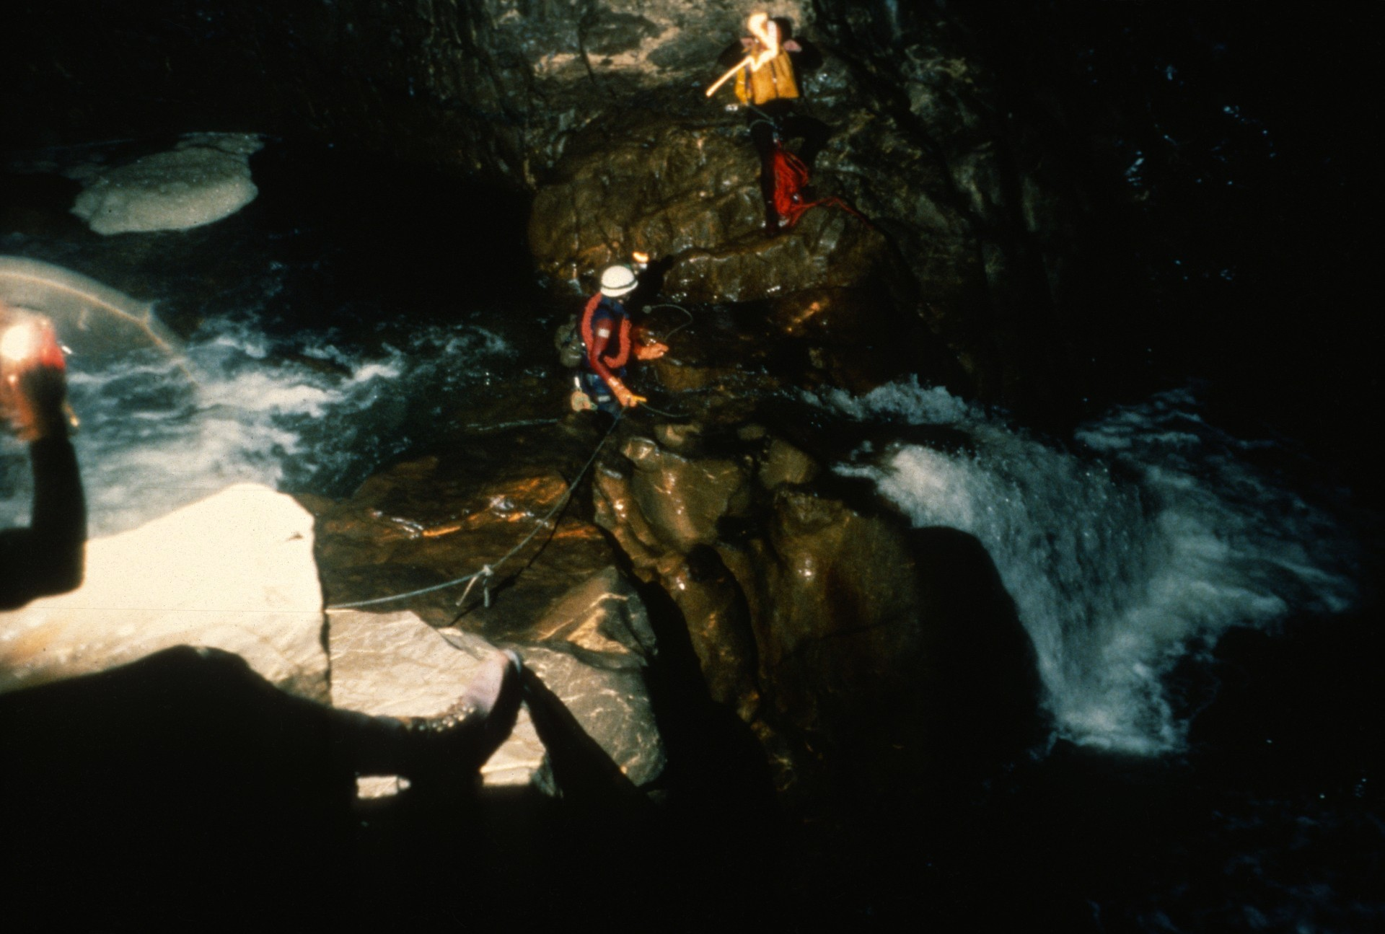
Notes:
The passage beyond led to the Twin Falls Room. Until this point no one had seen the cave's ceiling except in the entrance area; it was always lost in the heights of the narrow passage. But at Twin Falls the passage separated into two levels, with the lower part much smaller. Until this point it appeared that in case of flood one could always hope to climb the walls to sanctuary, but now it was clear the passage would flood completely.

Slide 24
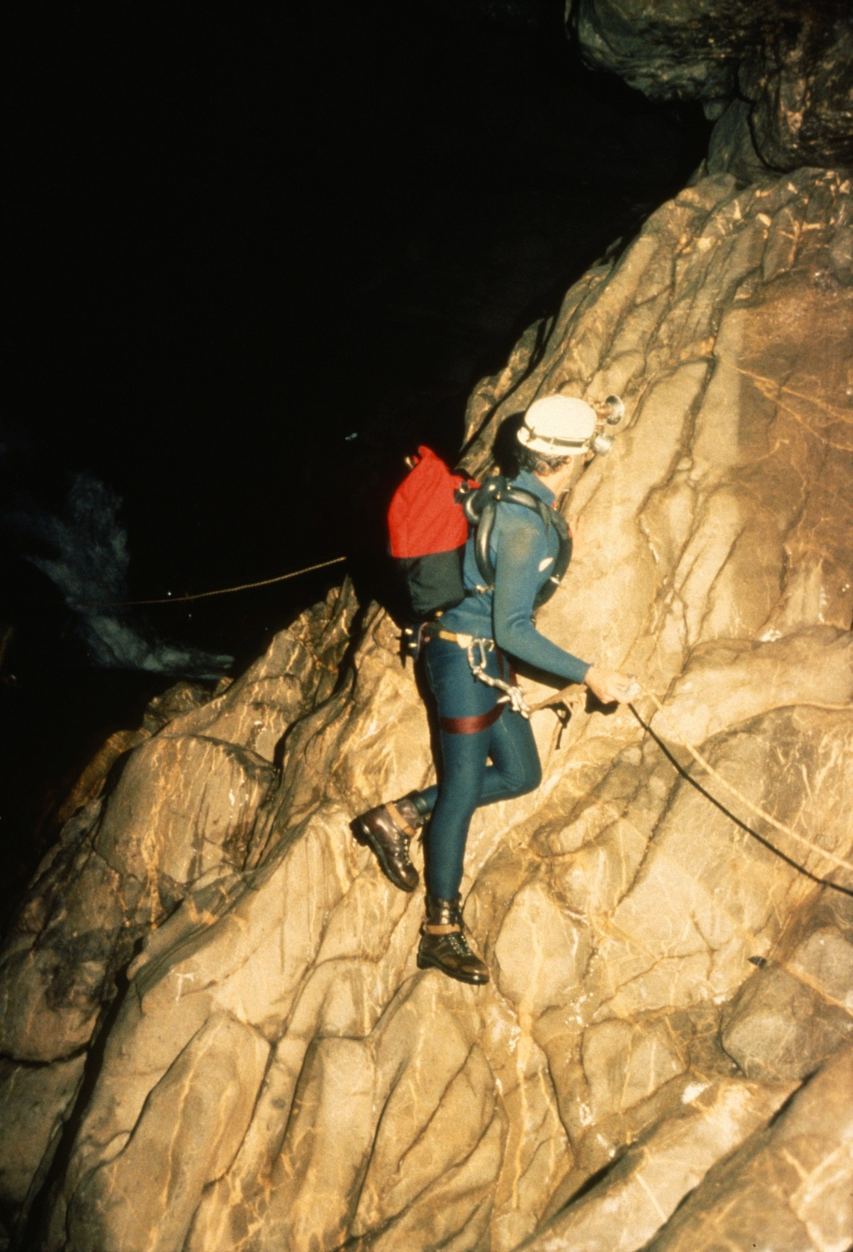
Notes:
Ric Finch traverses along the ledge at the end of the Twin Falls Room. After a rappel into fast water, a narrow chute leads to the top of a 7-meter falls. Below was a plunge pool named "Alien Pool. John Burk1ig and Paul Hill managed to get by it, but only after Burklig nearly drowned. The pool was bypassed by climbing to the "Hippo Seat," a high notch, and rappelling past Alien Falls, Alien Pool, and the next waterfall as well.

Slide 25
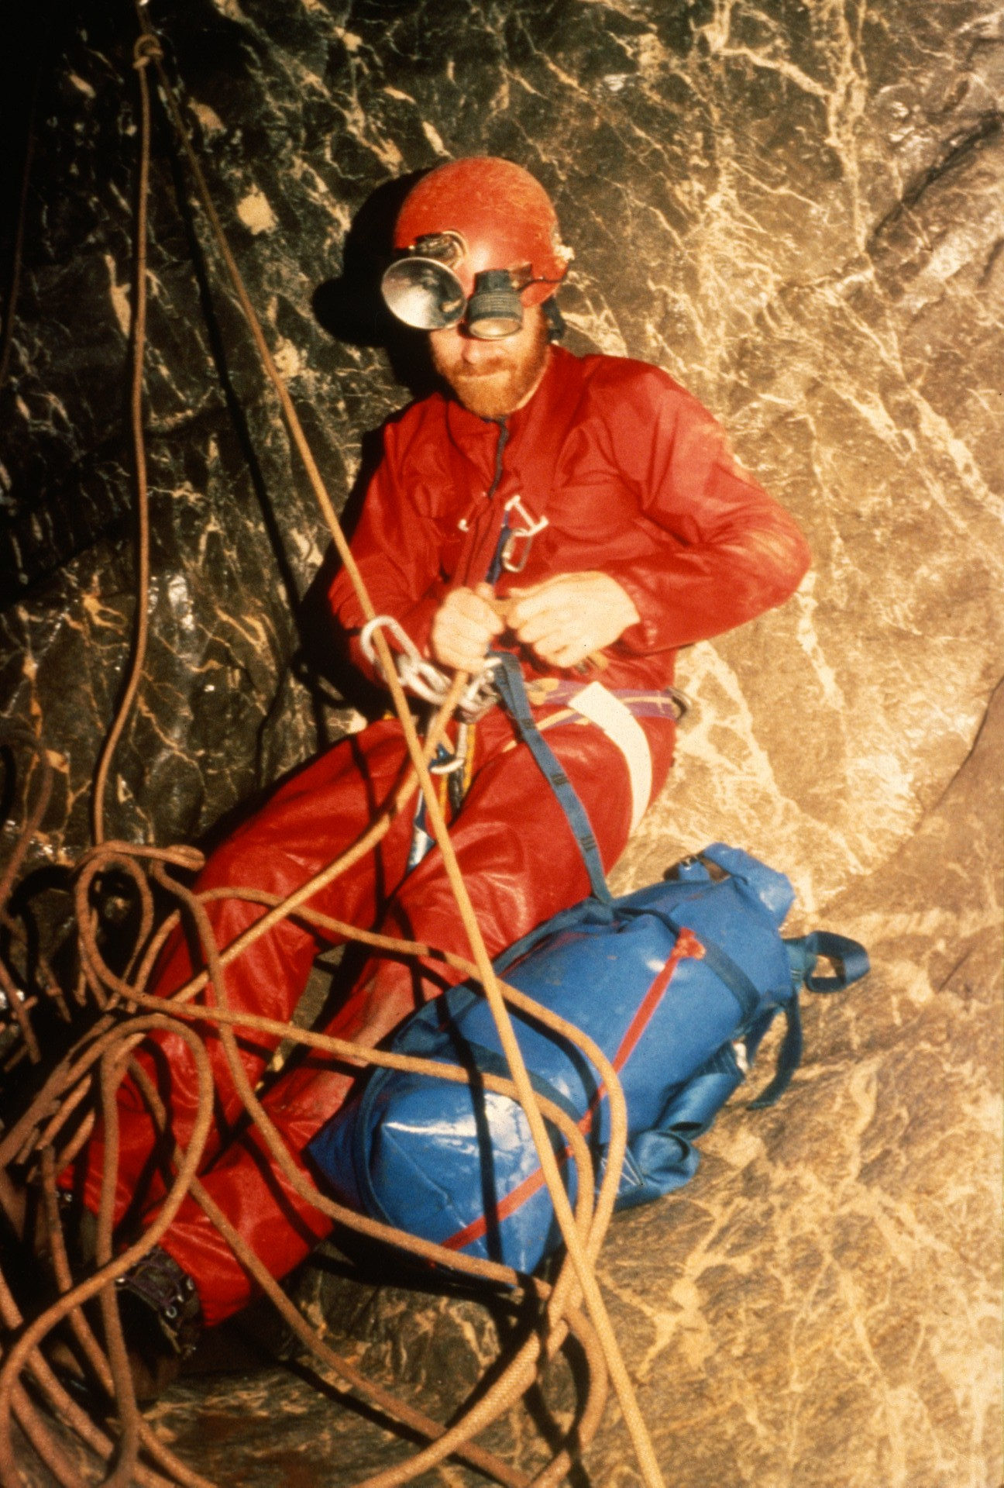
Notes:
Pete Carter at the bottom of the rappel below Alien Pool. The orange rope is 10mm Bluewater rescue rope. It performed extremely well as did the 9mm PMI rope normally used on the drops.

Slide 26
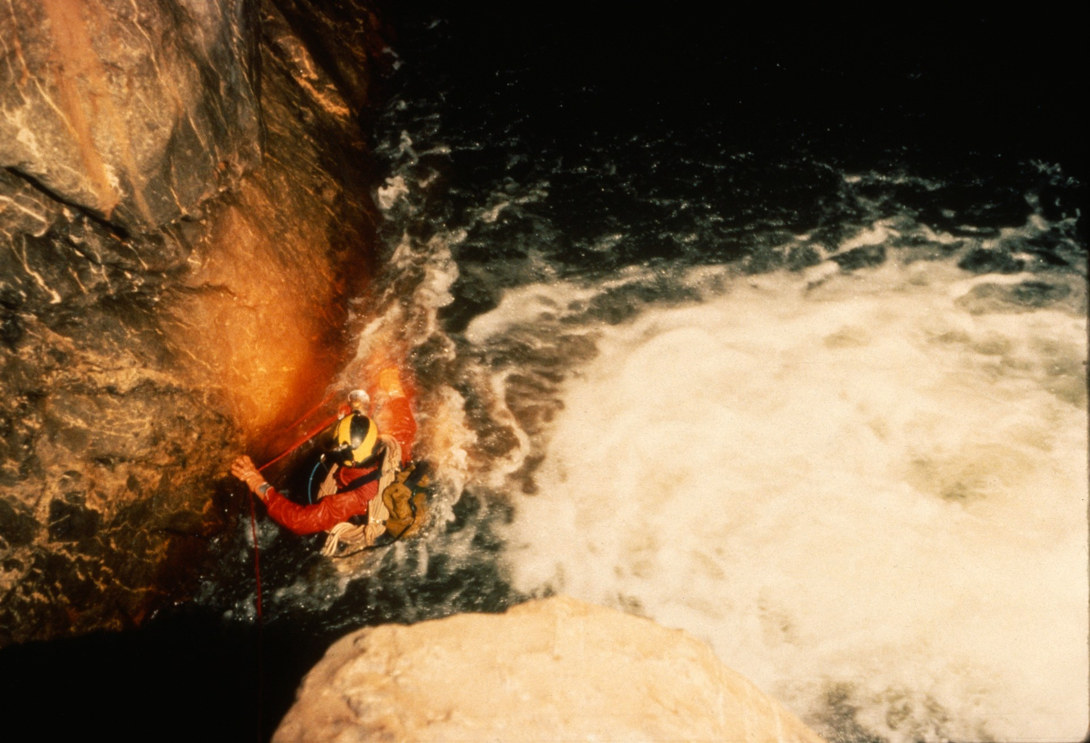
Notes:
Paul Hill makes his way along a wall pummeled by water from a 3-meter waterfall...

Slide 27
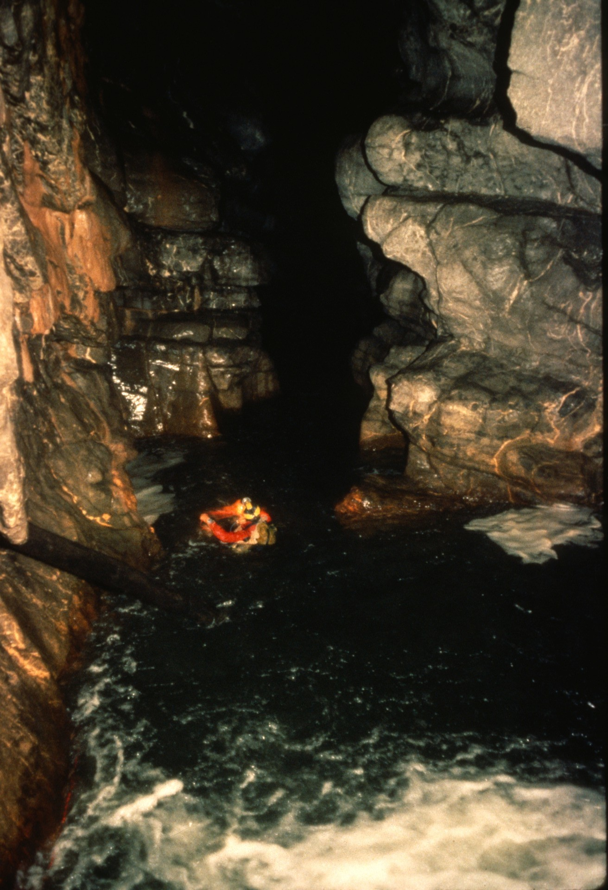
Notes:
…and continues down the canal. Beyond was another major waterfall over 10 meters in height. An aid climb led to the ledge on the left.

Slide 28
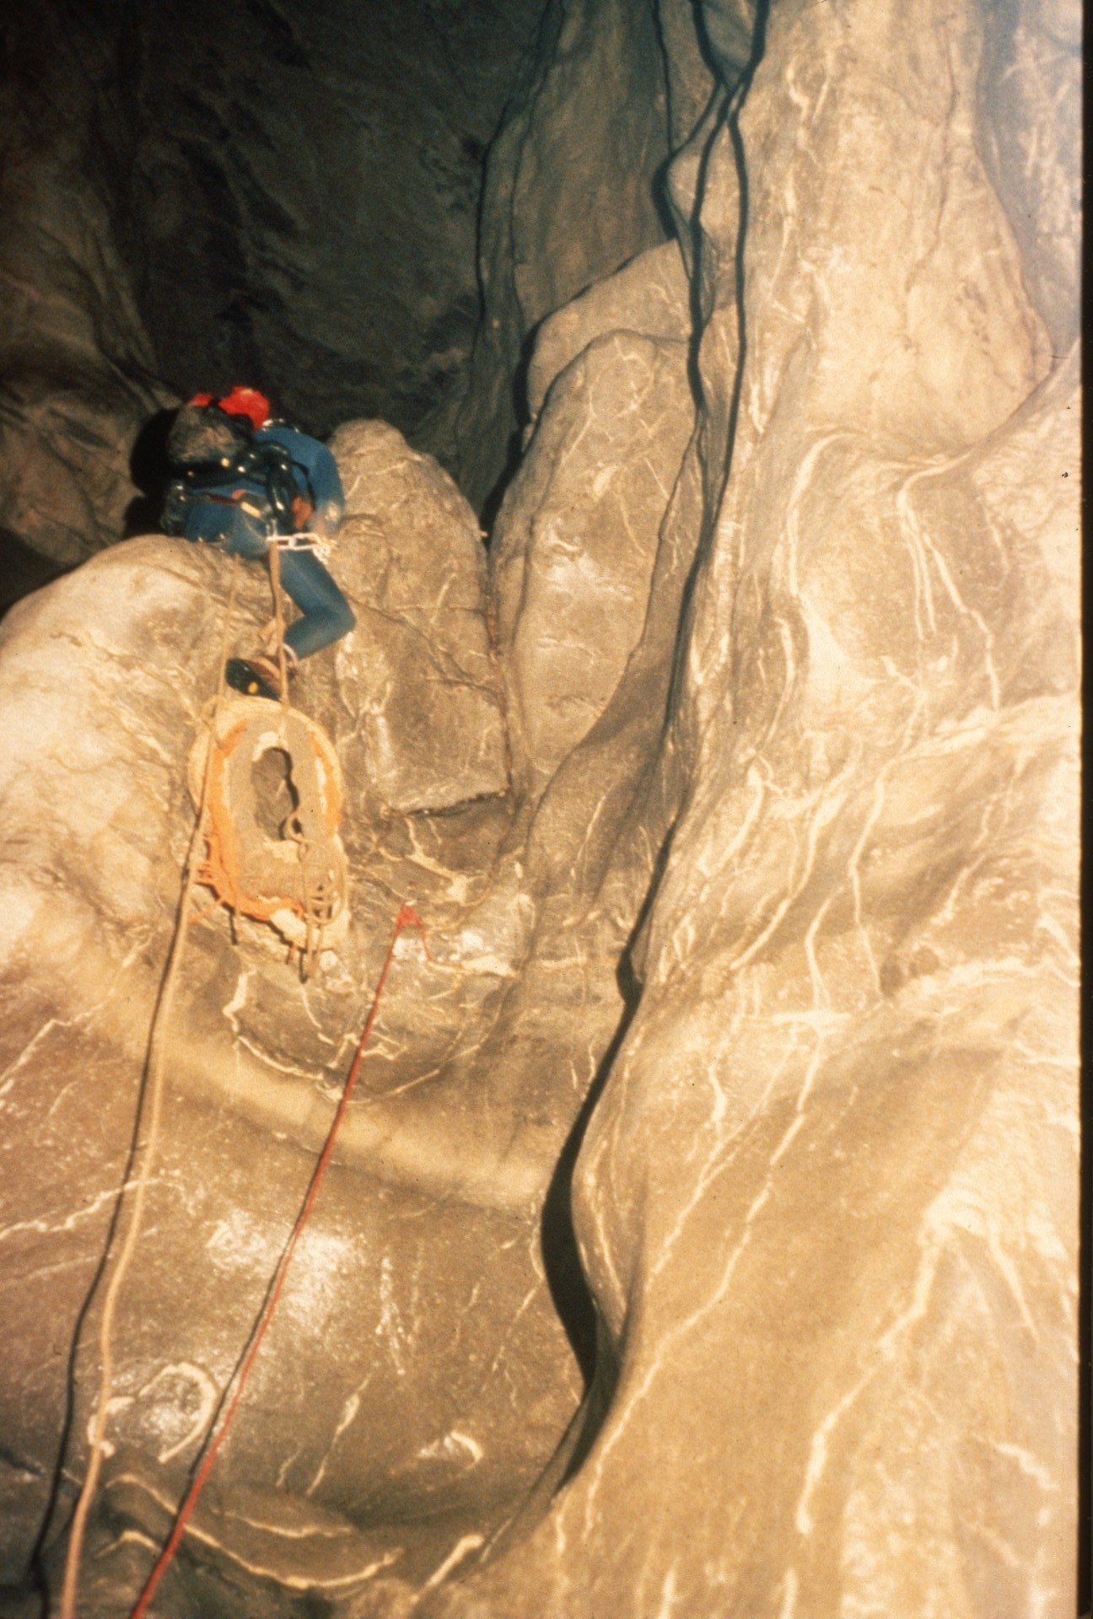
Notes:
The same ledge seen from below.

Slide 29
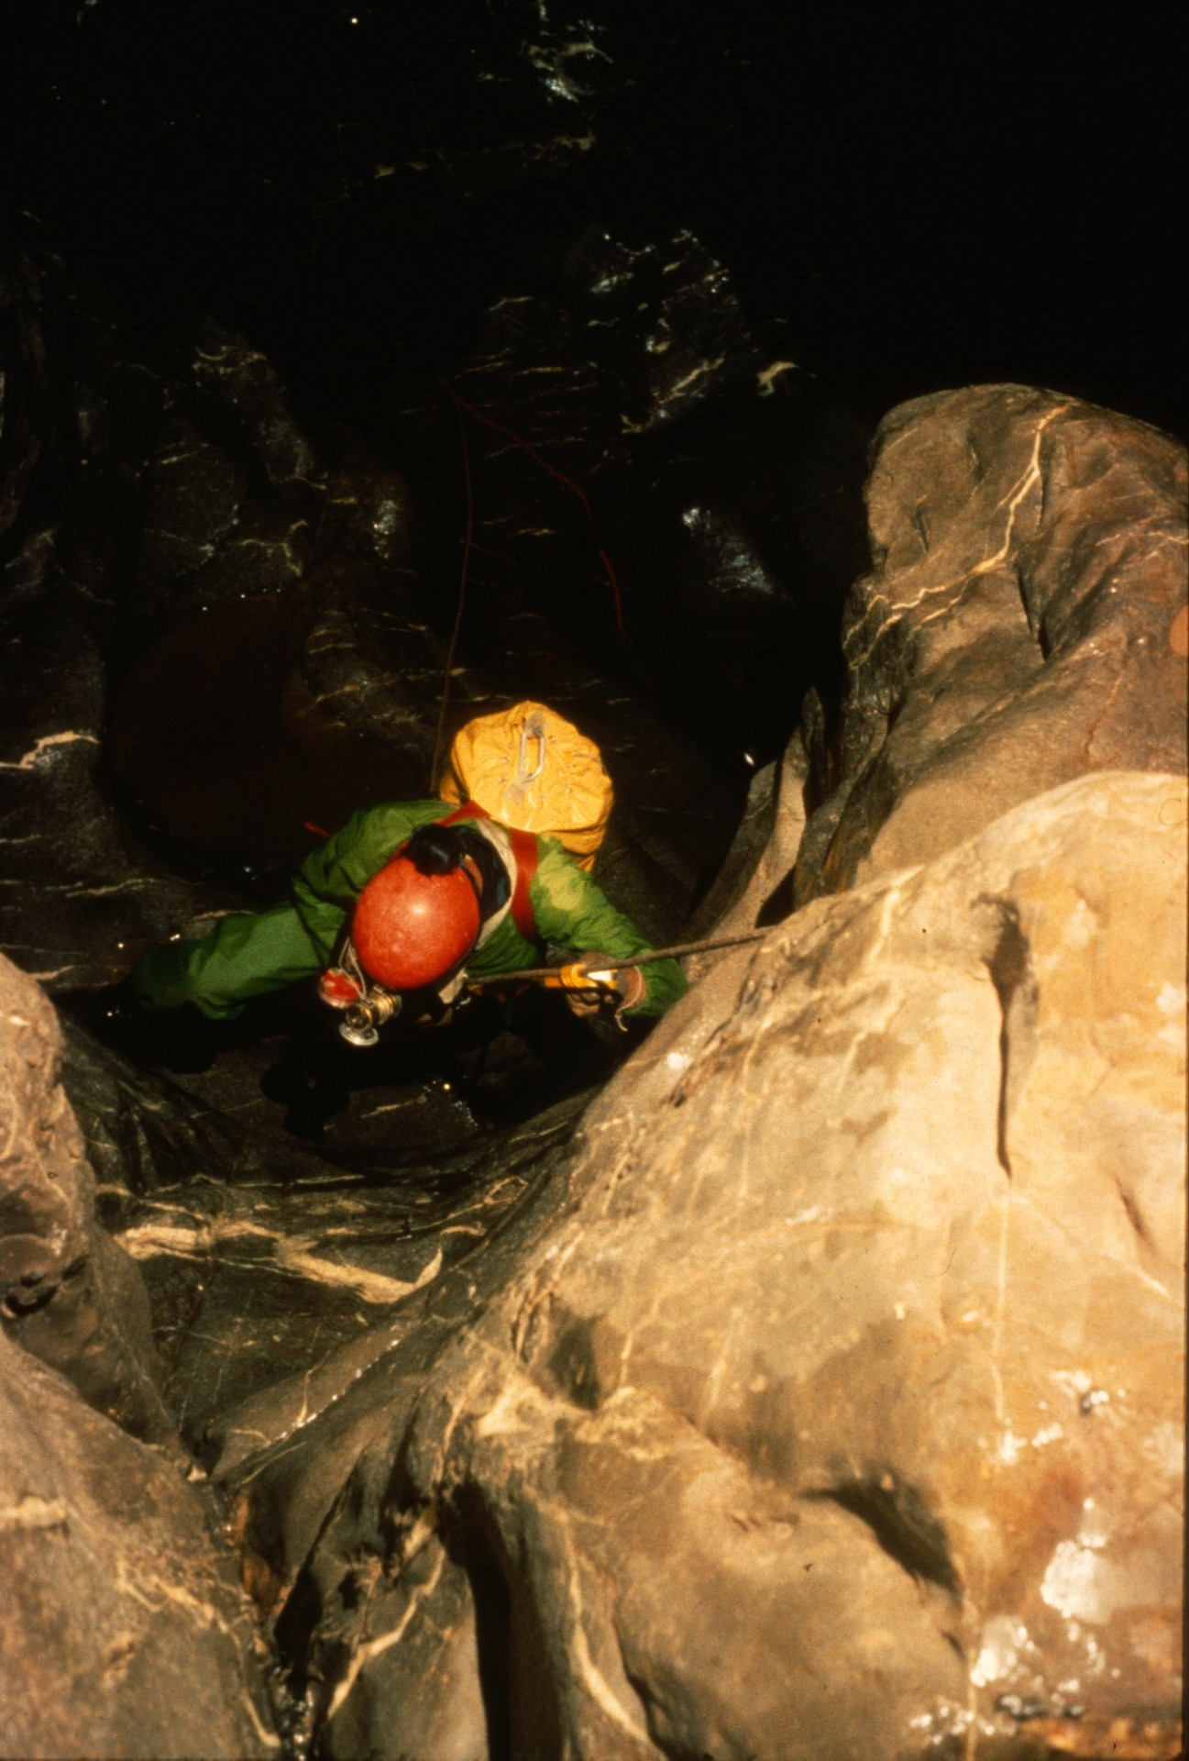
Notes:
From the ledge they could see rapids and another waterfall which they named "86 Falls''; the end of the 1986 expedition.

Slide 30
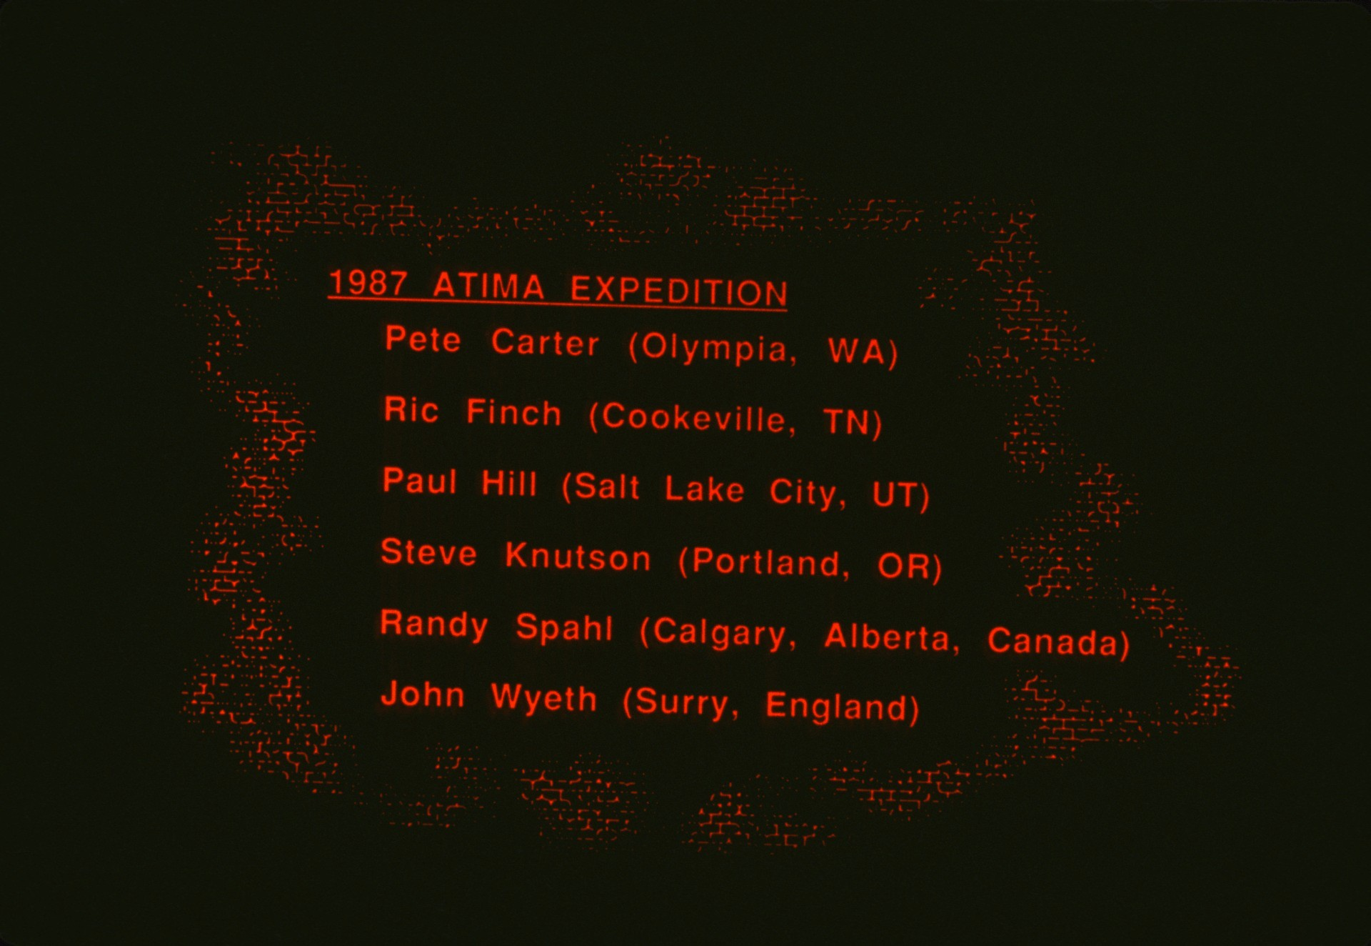
Notes:
The 1987 expedition included Pete Carter, Ric Finch, Paul Hill, Steve Knutson, Randy Spahl, and John Wyeth. We began with just four; Pete Carter arrived in time for the first through trip between entrances. Ric Finch came in time for the survey and photo "through" trip and de-rigging the cave. Pete and Ric were valuable additions, but the brunt of the effort to connect the entrances was done by the others. Once they rigged the cave, the trip was much easier. That is, the through trips were much easier.

Slide 31
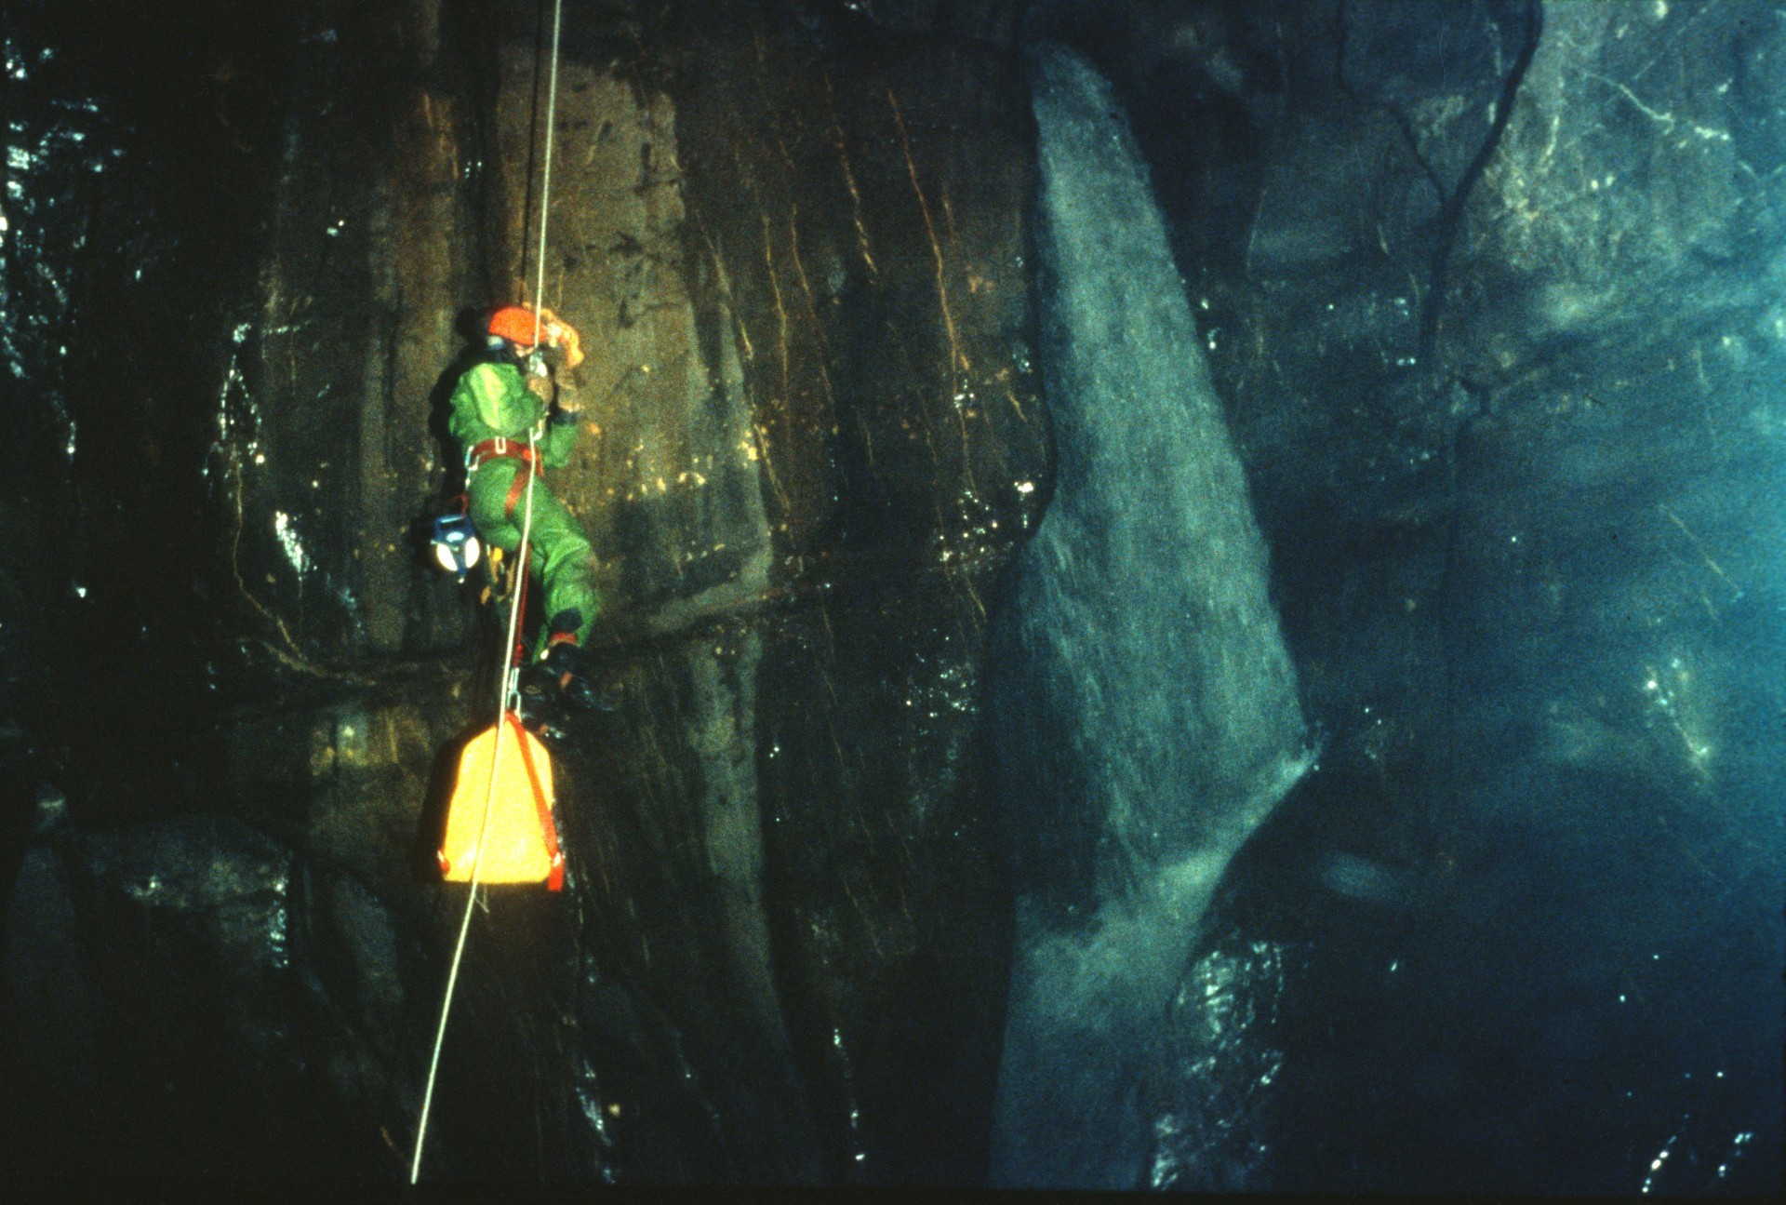
Notes:
(Text is missing… Appears to be John Wyeth rappellling)

Slide 32
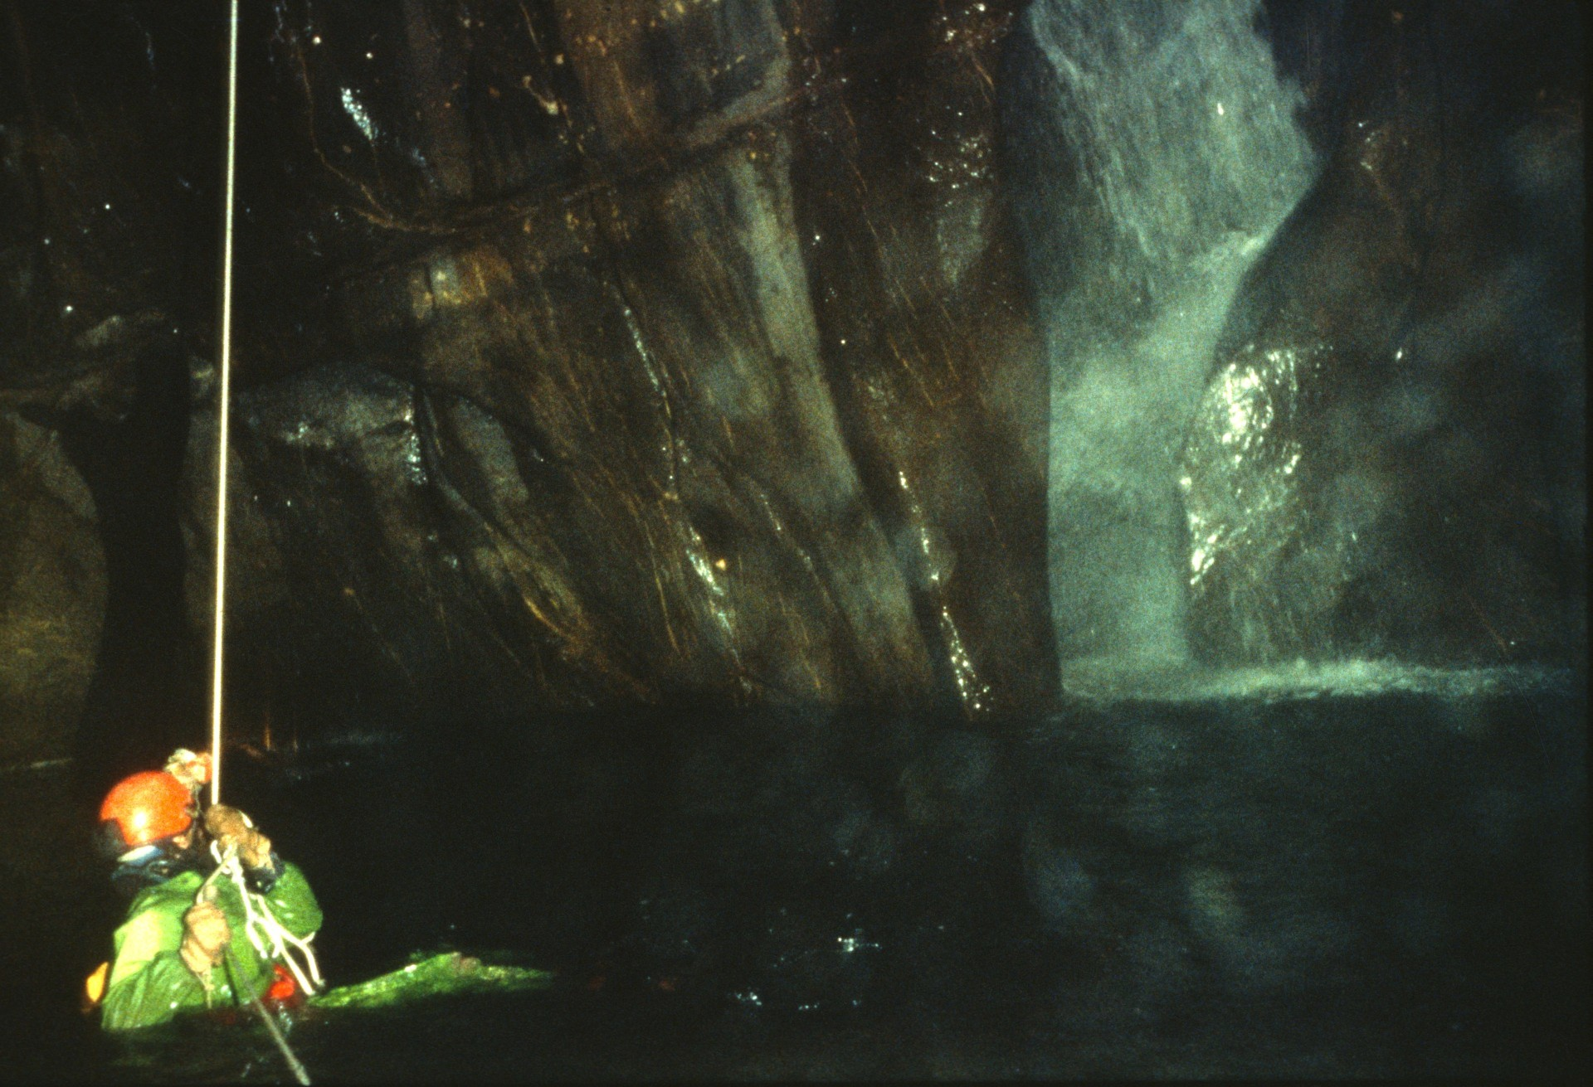
Notes:
…into the pool at its base.

Slide 33
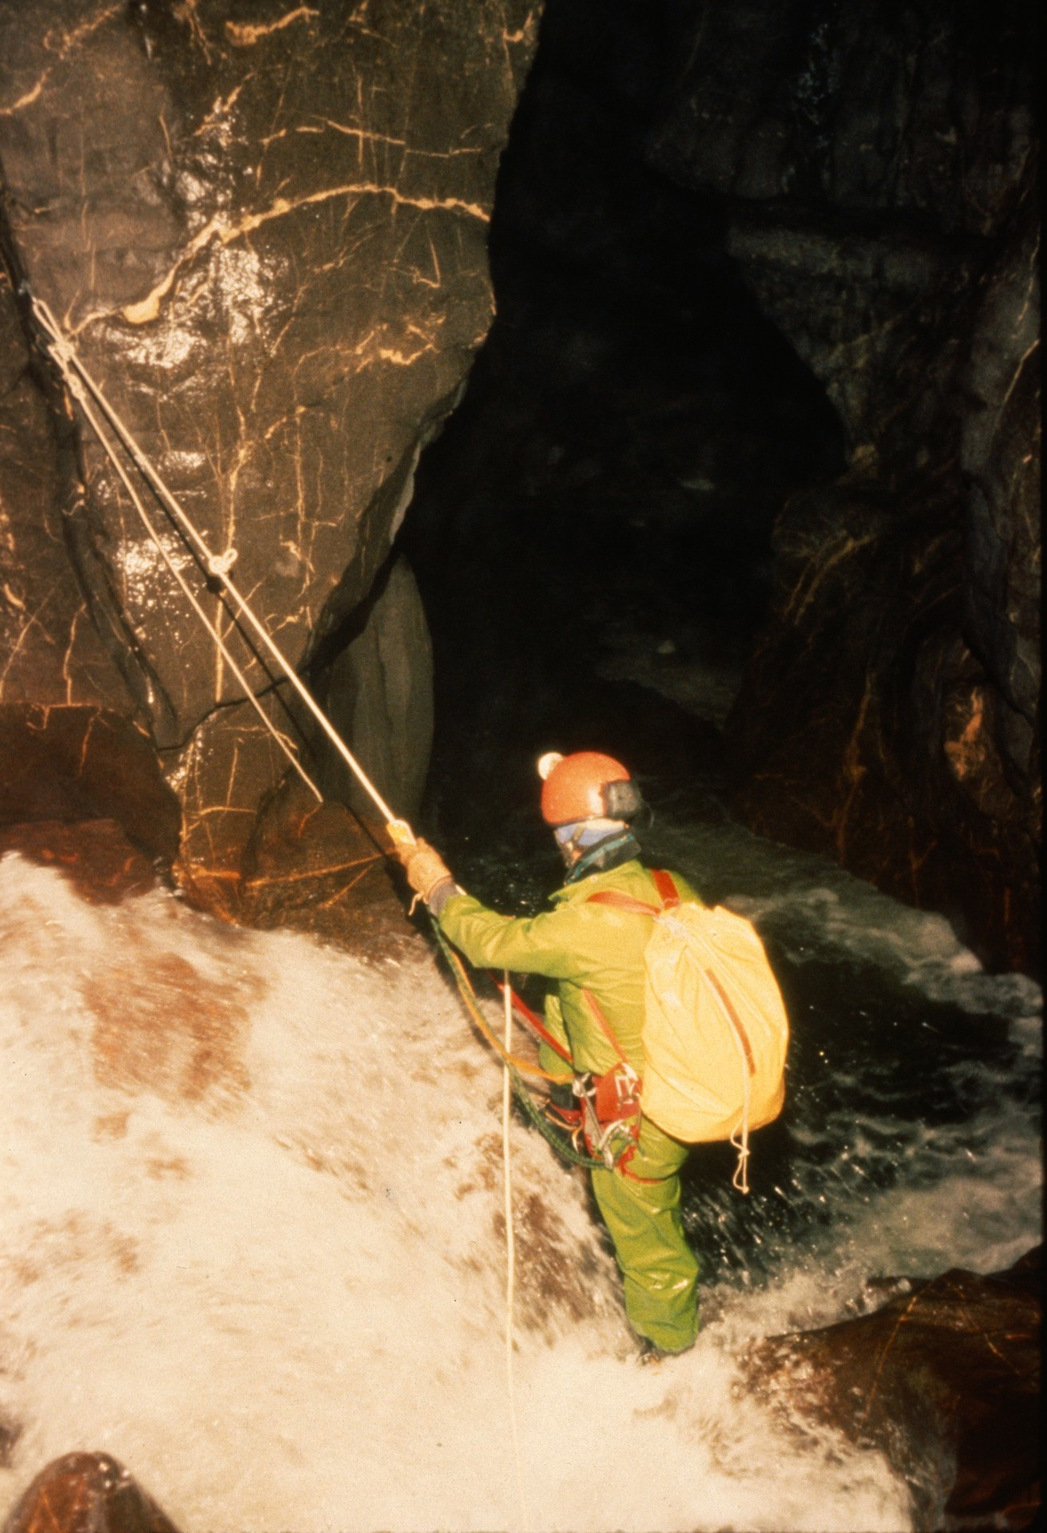
Notes:
Here he crosses to the right wall on a natural bridge. The main water flow pours into a hole just to the right, passes under him and proceeds over a 3-meter drop to his left.

Slide 34
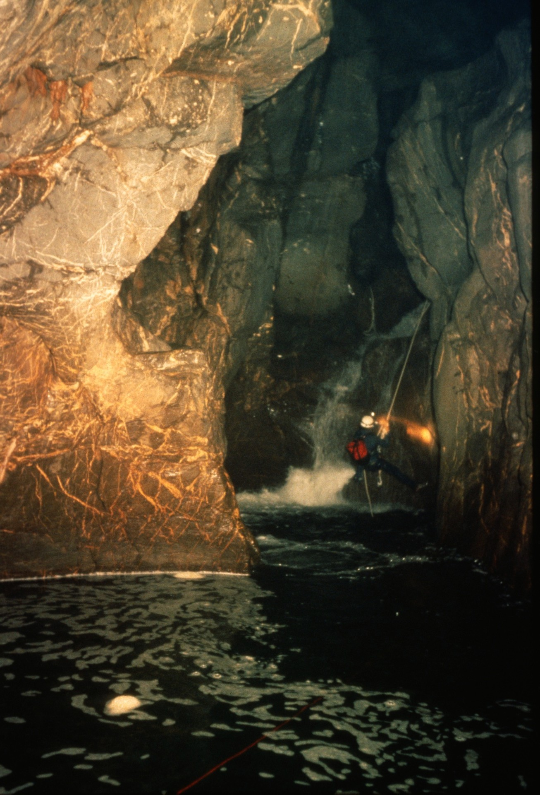
Notes:
Ric Finch descends the 3-meter falls. Beyond the pool shown here the cave changes character, becoming more broad and offering high ledges. Two such ledges were ascended and then used to bypass several waterfalls.

Slide 35
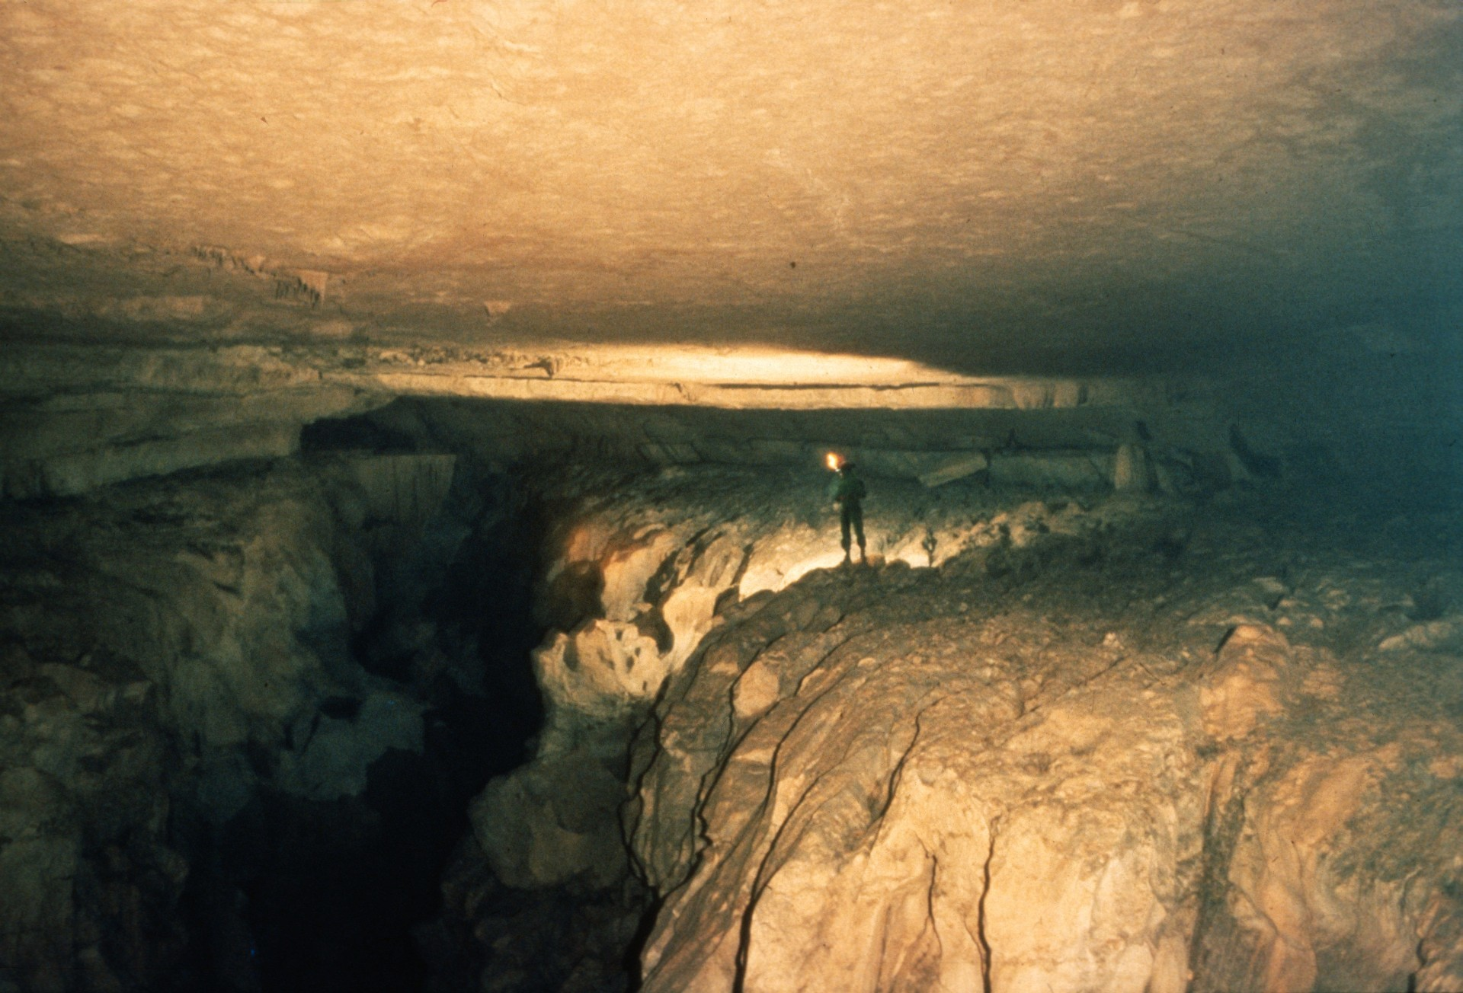
Notes:
The Great Ledge with the water 30 meters below.

Slide 36
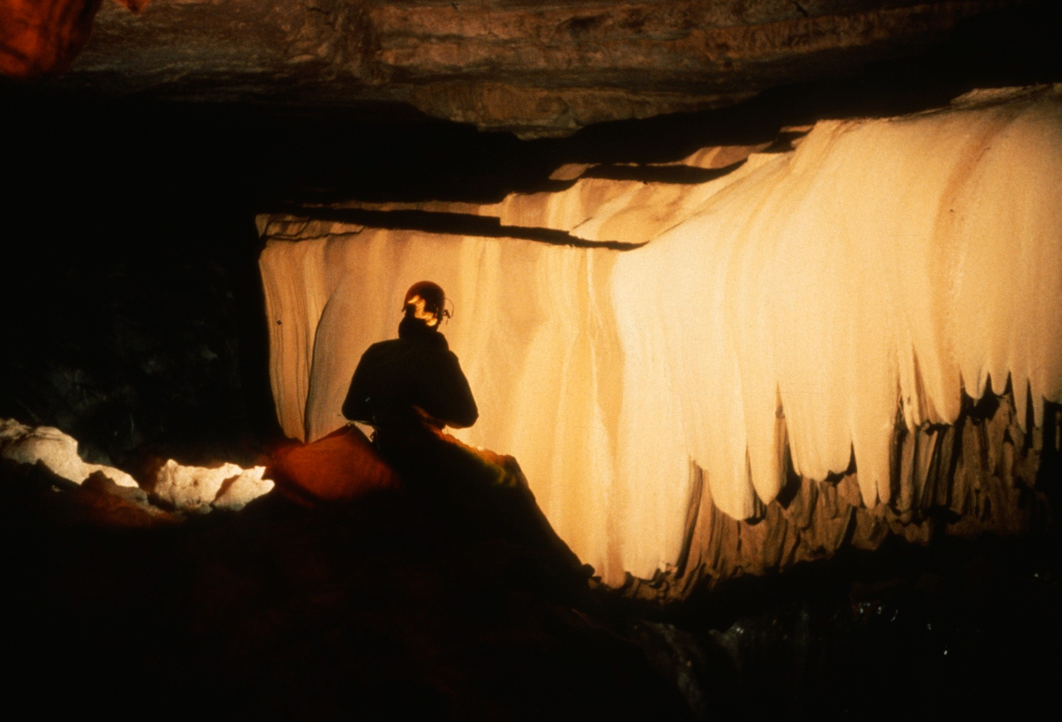
Notes:
The break-through team of Carter, Hill and Spahl thought they were on their way out when they got to this point and named the flowstone "The Final Curtain."

Slide 37
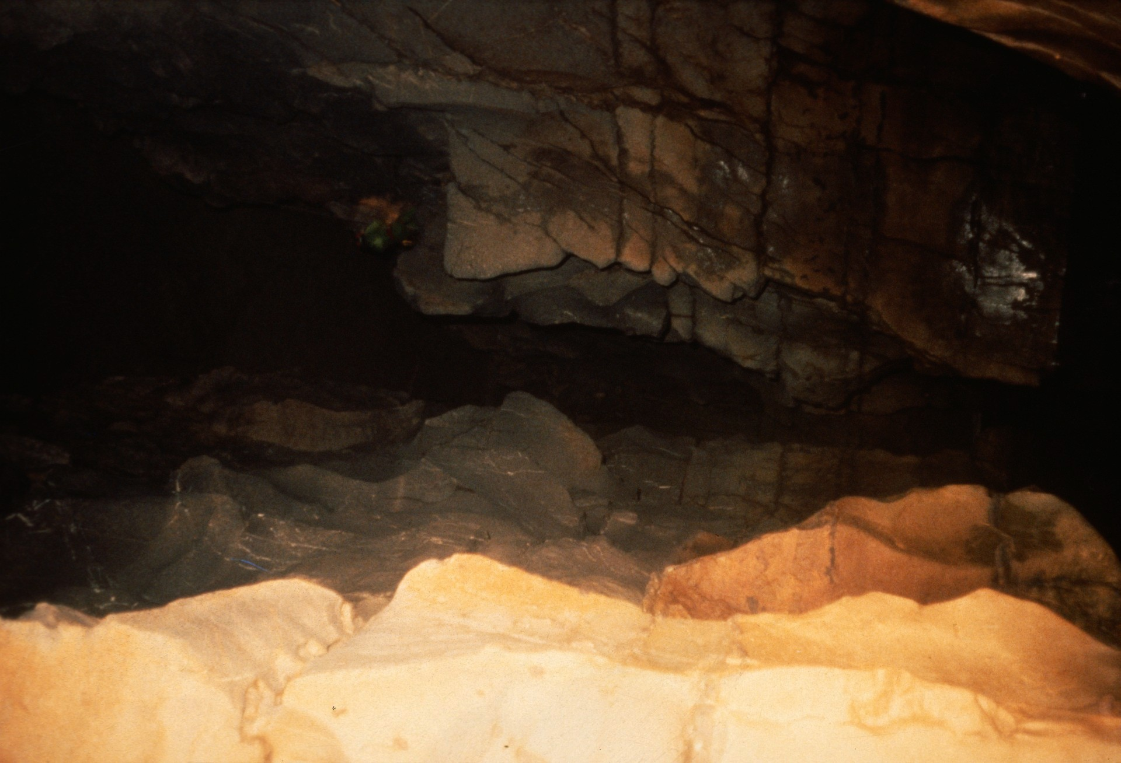
Notes:
The route continued down the 30-meter rappel to the river below.

Slide 38
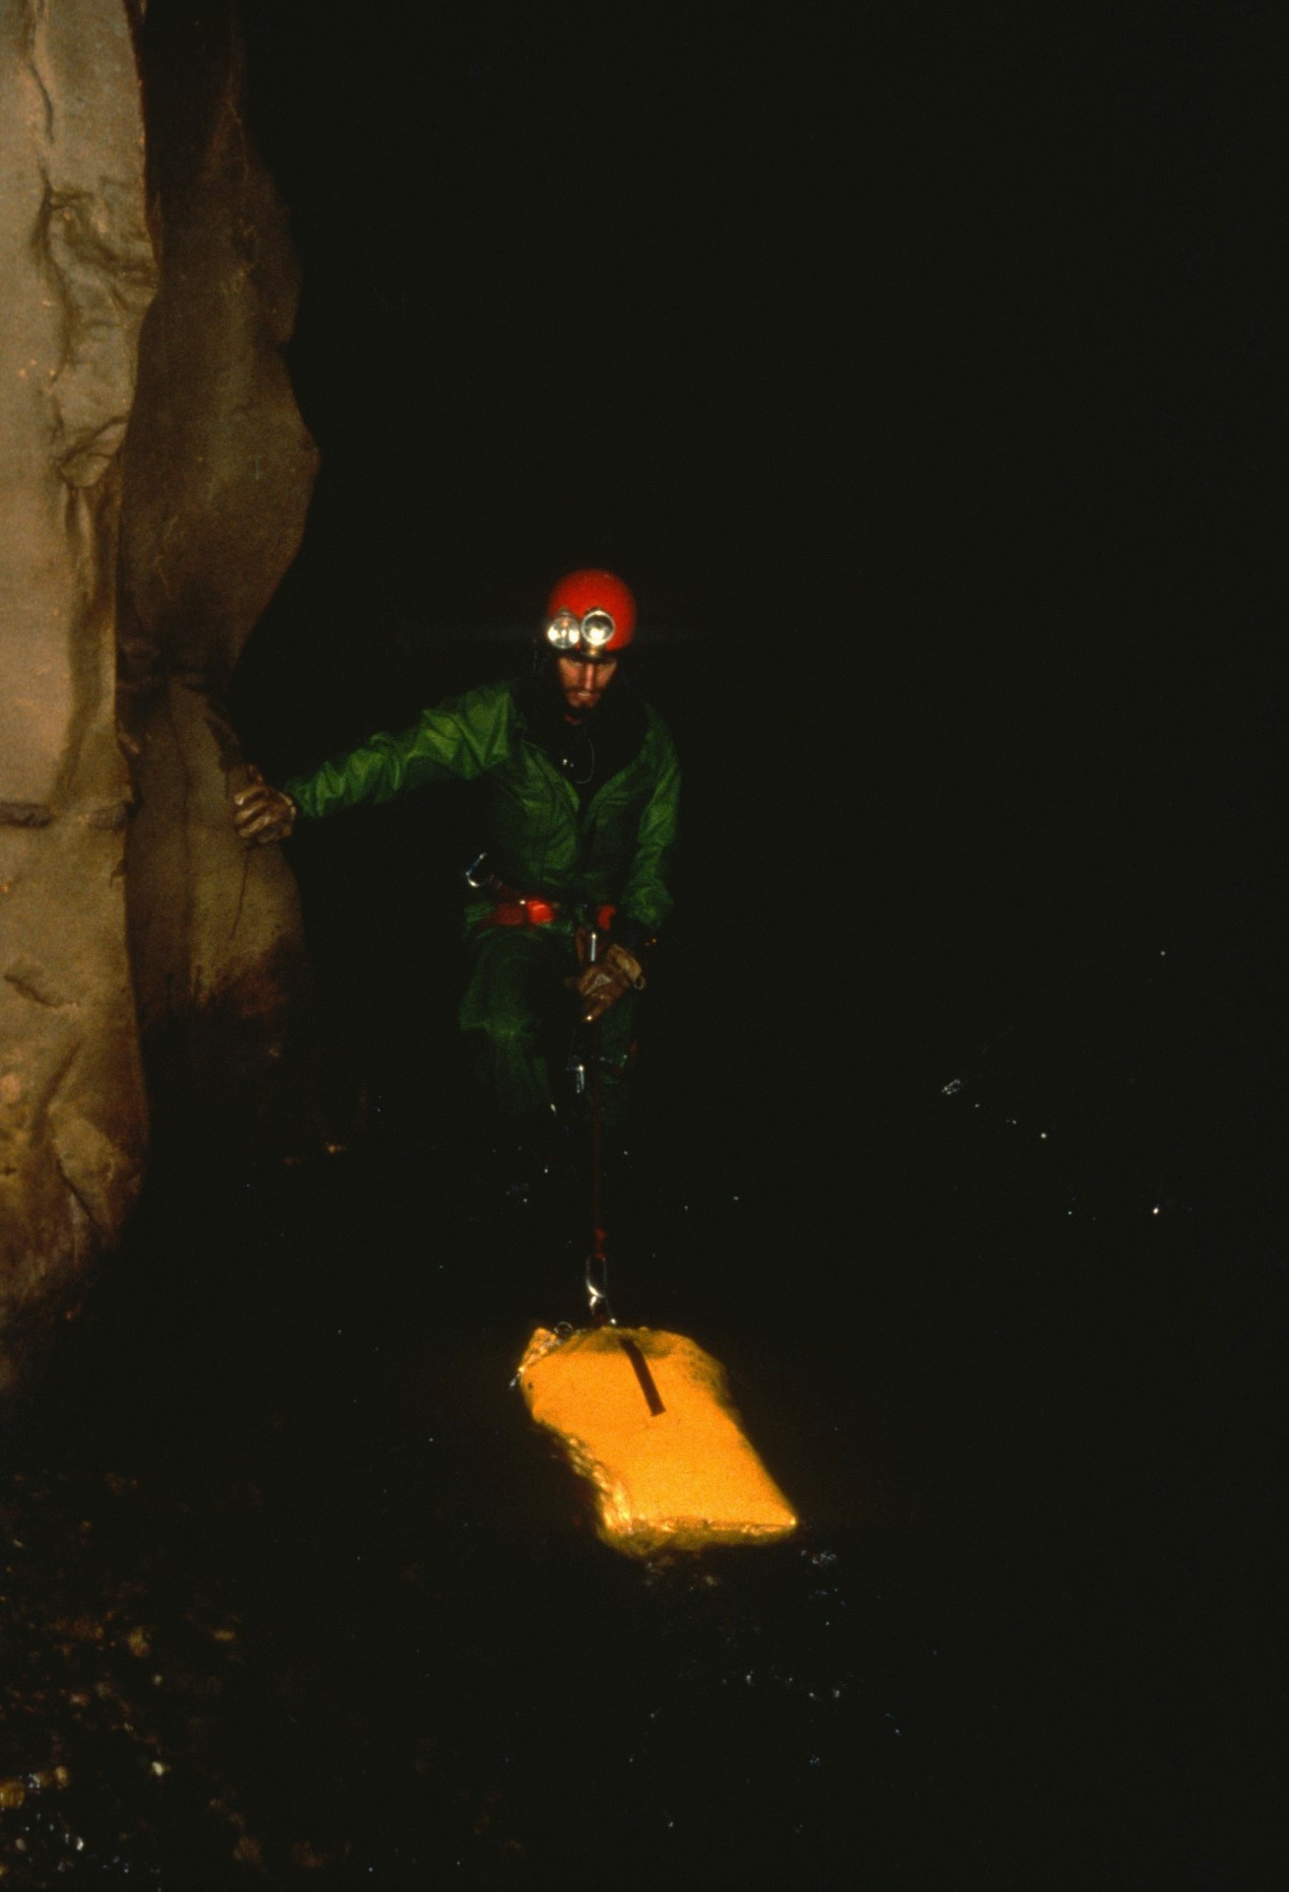
Notes:
John Wyeth going down river...

Slide 39
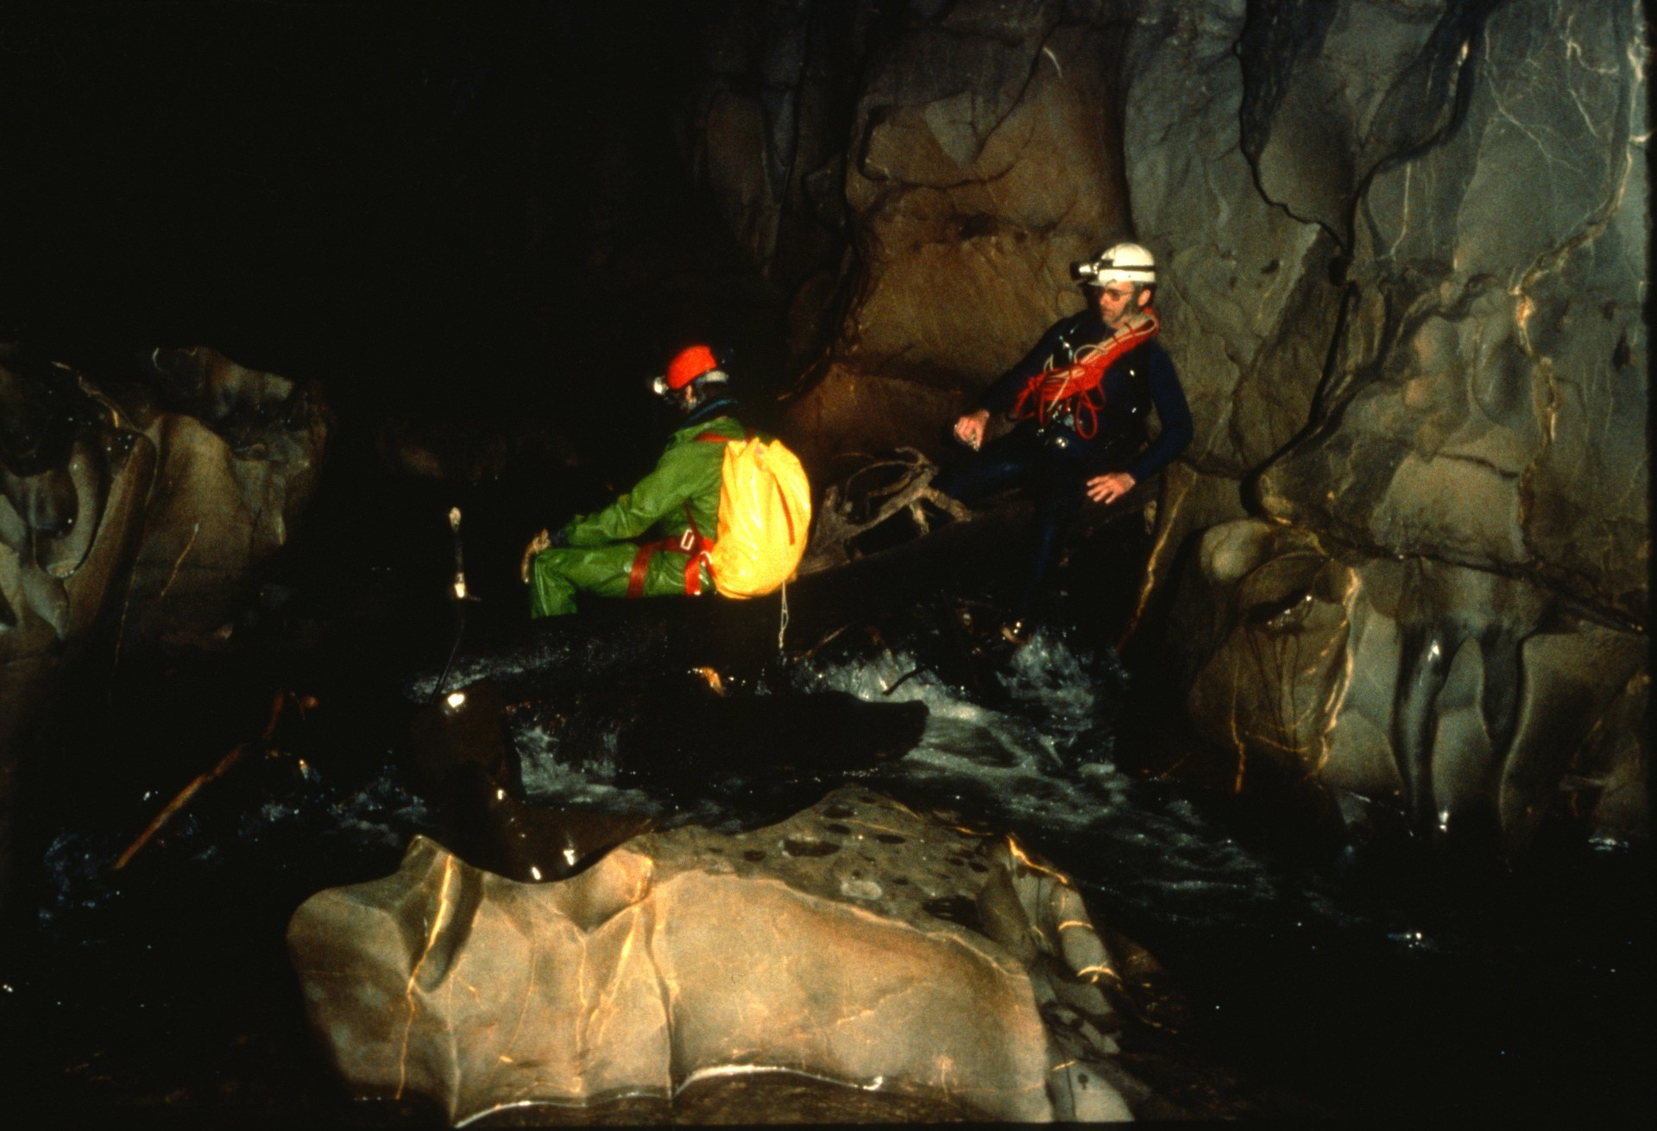
Notes:
…stopping on a log with Ric Finch along the way. The cave was now horizontal with only short waterfalls up ahead. It's still a kilometer to the lower entrance, and every footstep on slimy rock.

Slide 40
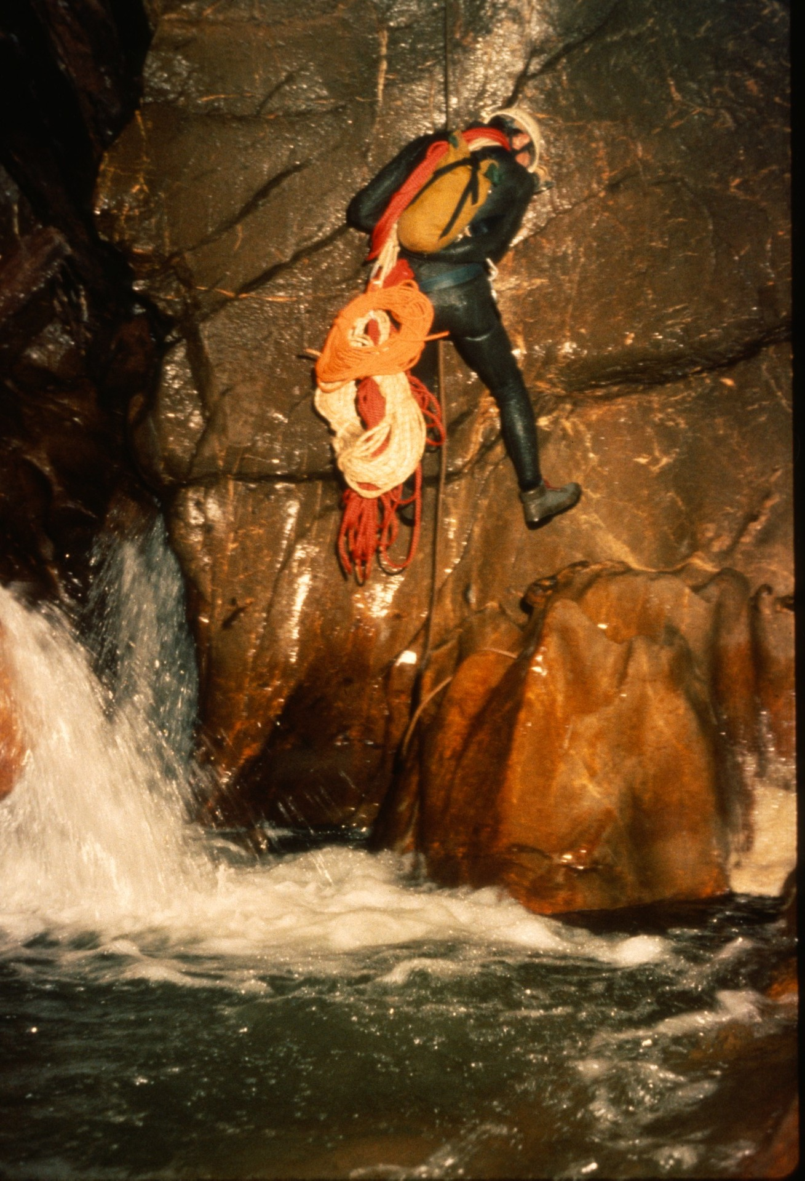
Notes:
Randy Spahl does a short rappel with a load of rope. The cave was "de-rigged" via a pull-down through trip.

Slide 41
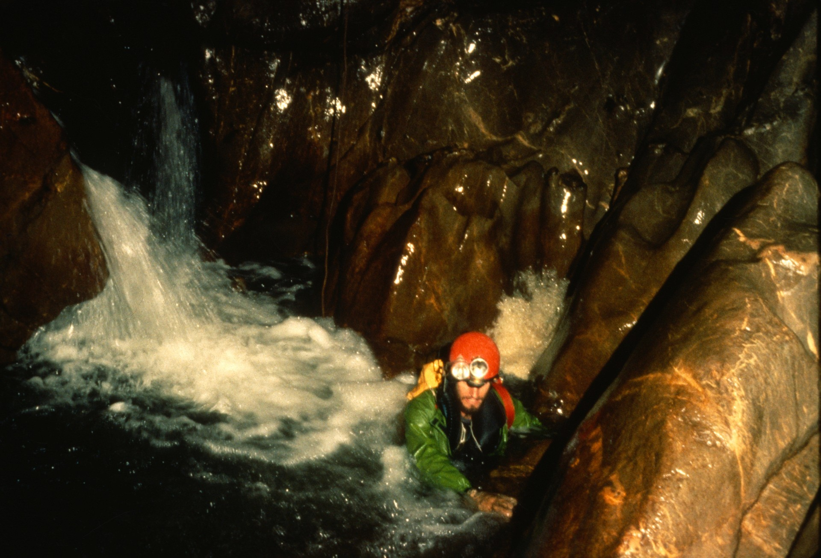
Notes:
John Wyeth in turbulence below a small waterfall.

Slide 42
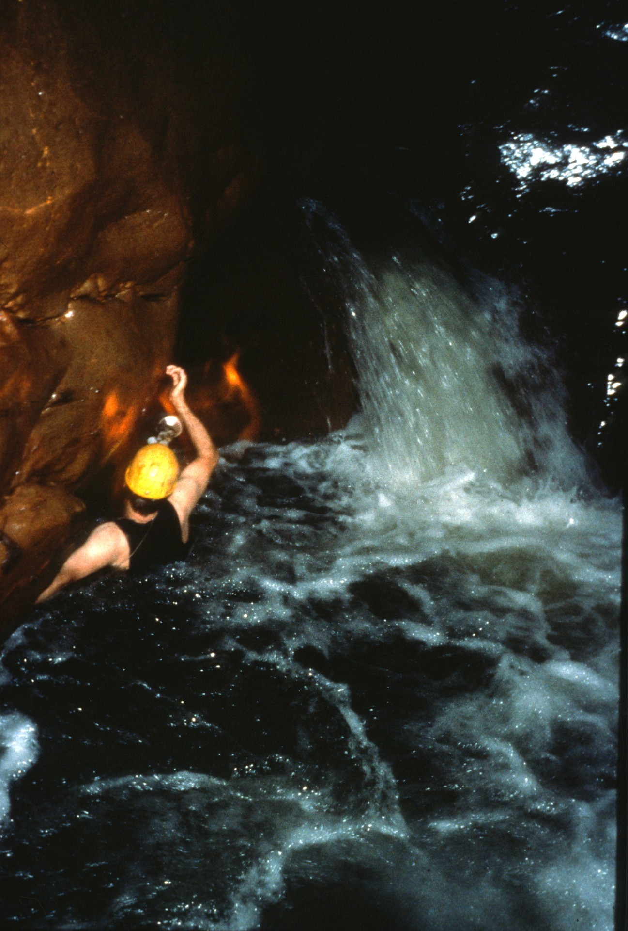
Notes:
Small waterfalls such as this one were common.

Slide 43
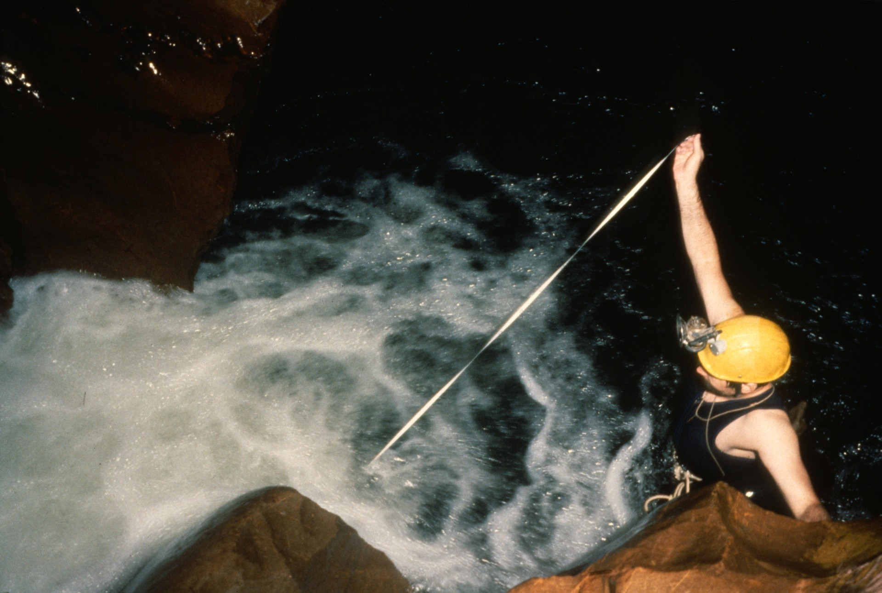
Notes:
Mark Stock at the front end of the survey team. The tape had a tendency to get caught in the water.

Slide 44
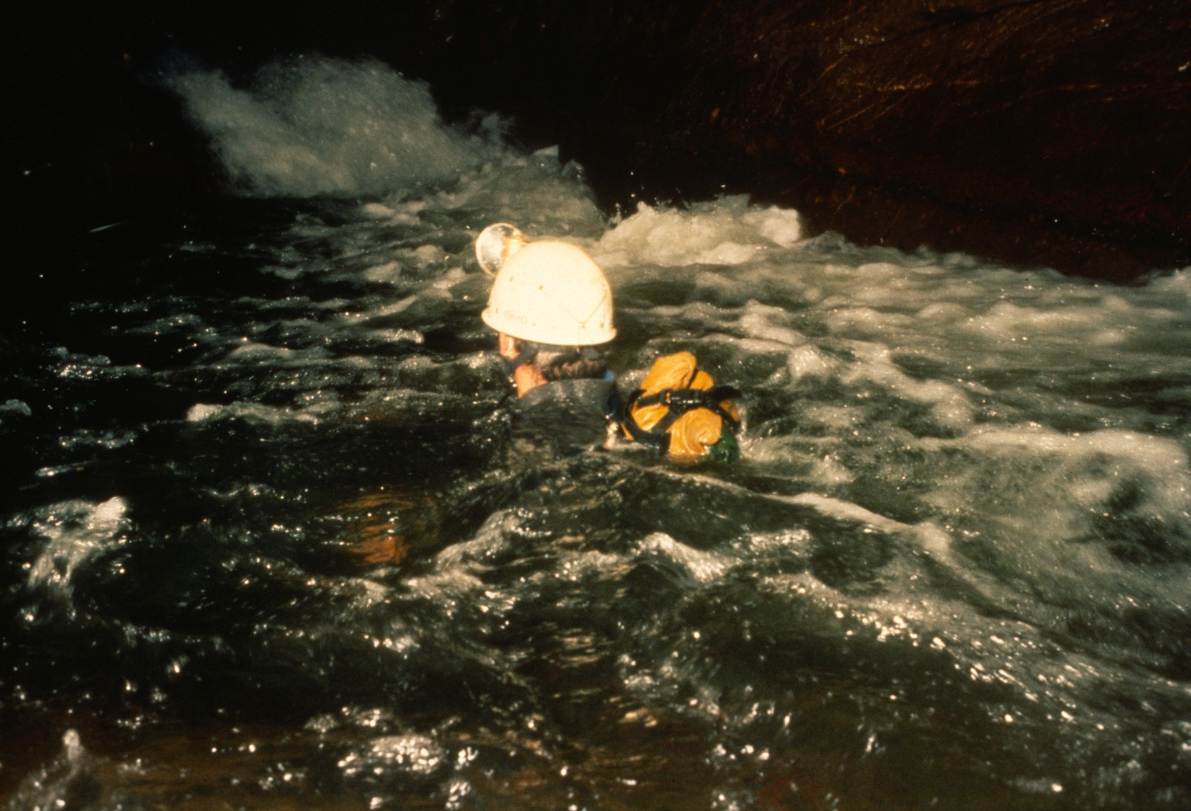
Notes:
Randy Spahl in a swim.

Slide 45
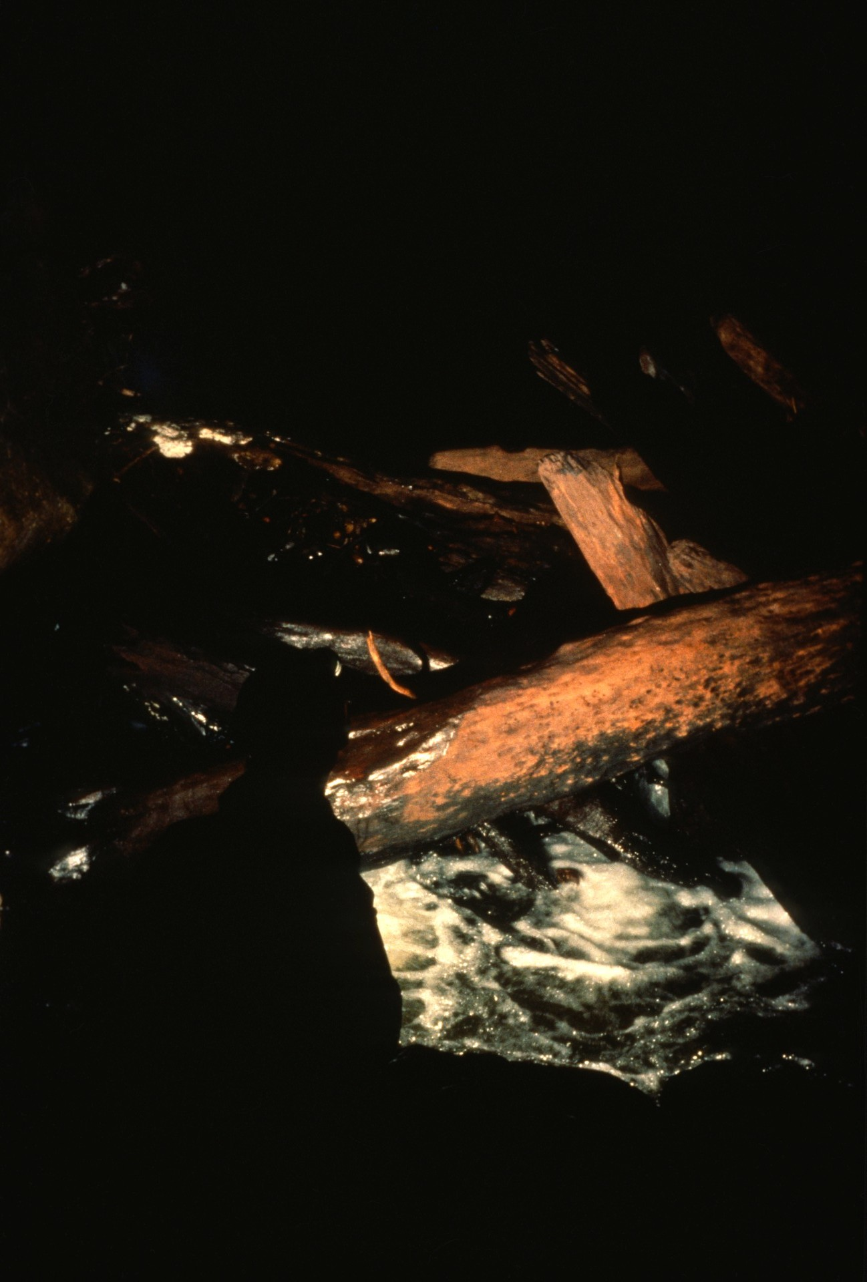
Notes:
Log jams occasionally filled the passage and moved between expeditions.

Slide 46
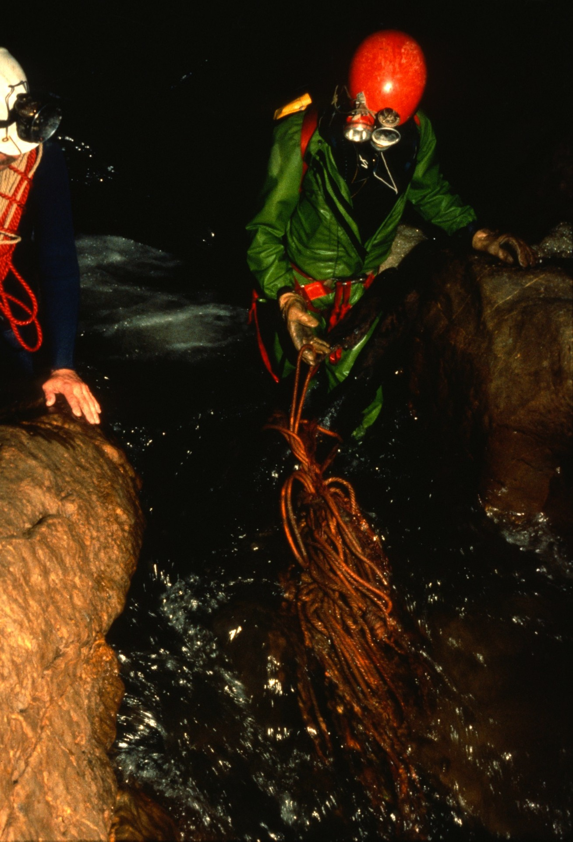
Notes:
A wad of rope that had washed away during a previous winter flood. We took it out, but were unable to untangle it and gave it to a local who seemed pleased to have it.

Slide 47
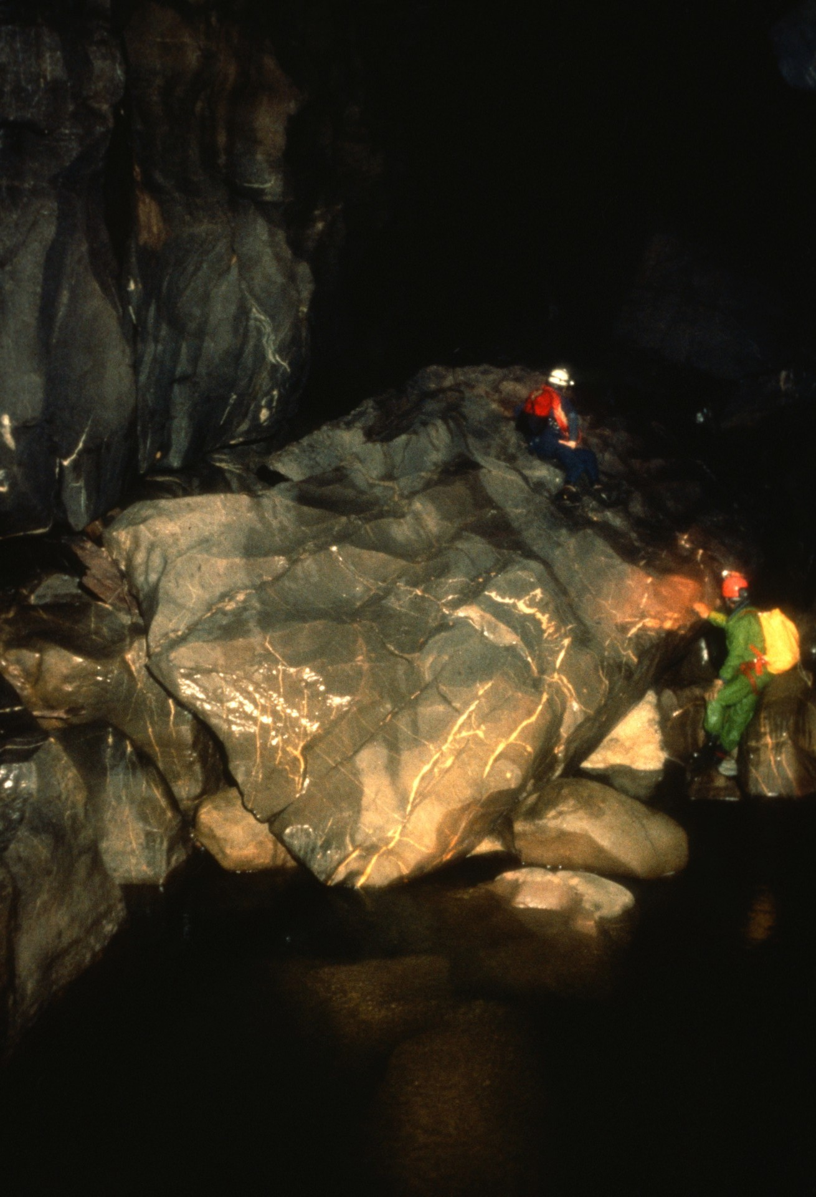
Notes:
Every bit of the cave was hazardous because of the slimy wet rock. Even flat ledges could "do you in."

Slide 48
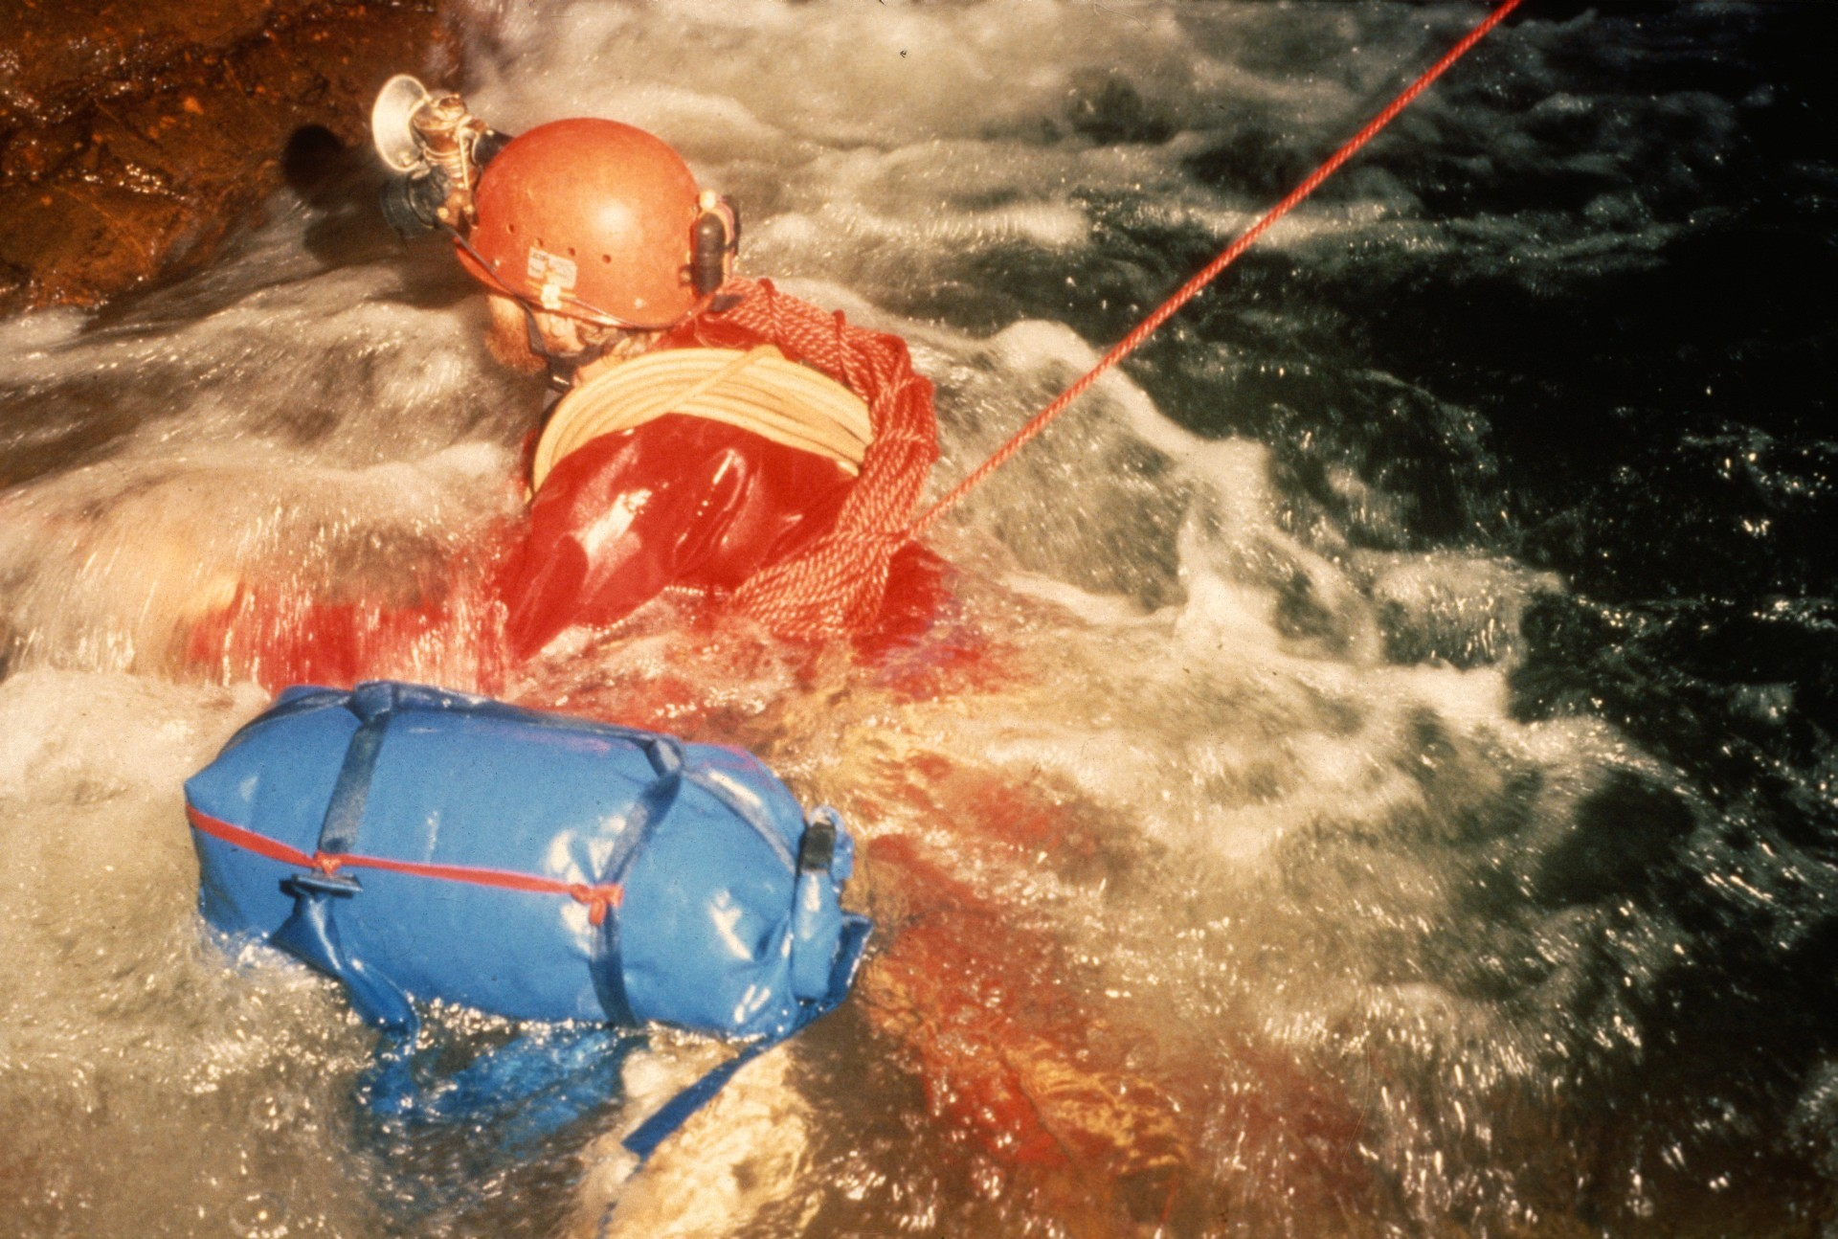
Notes:
(Text is missing…)

Slide 49
Notes:
Continuing downstream in the lower cave...

Slide 50
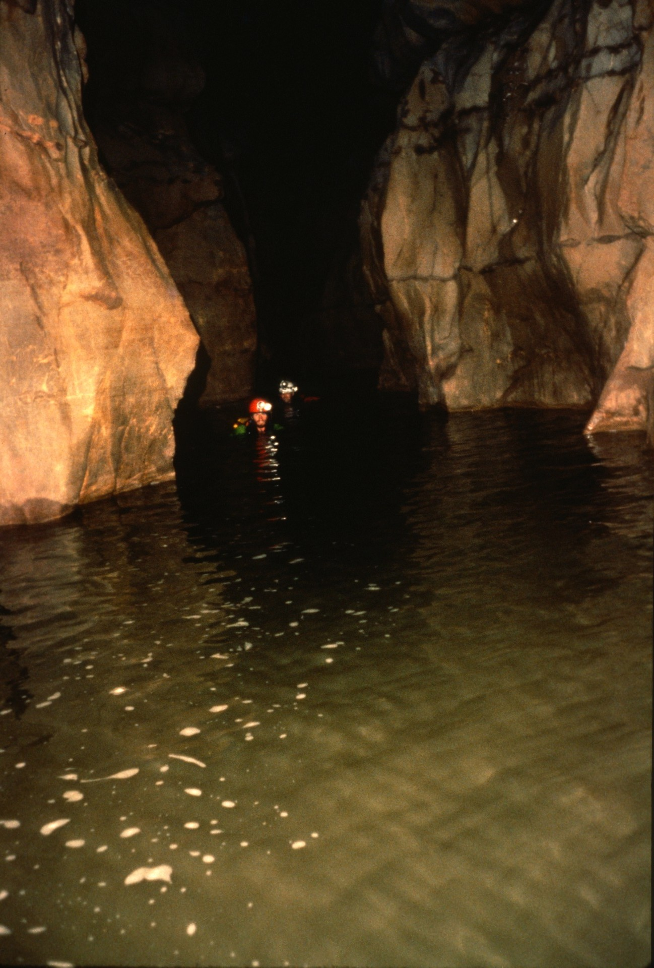
Notes:
…we reached a long pool, only part of which is shown.

Slide 51
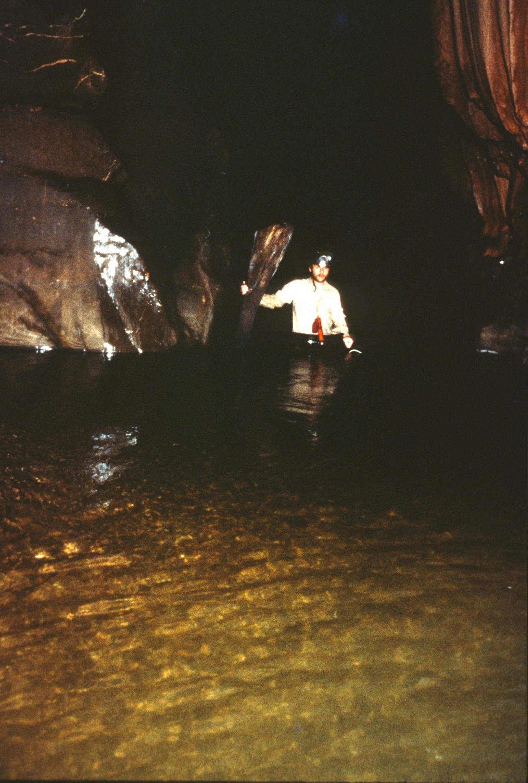
Notes:
It was periodically interrupted with sand bars,..

Slide 52
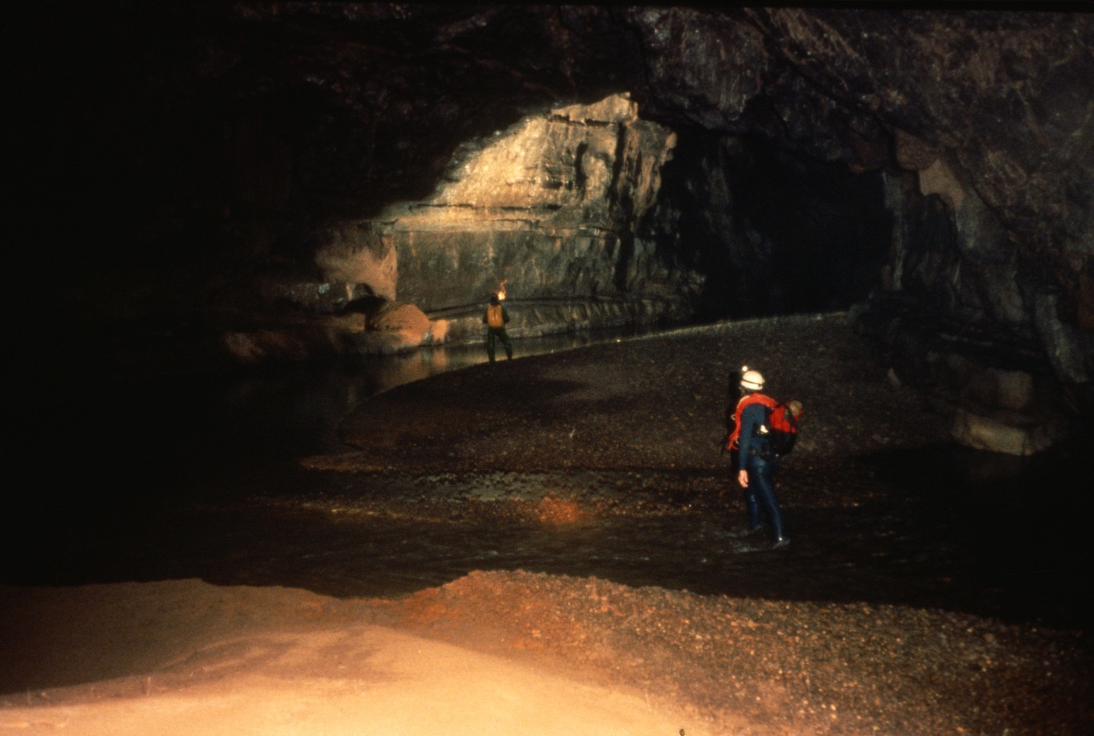
Notes:
…with the river meandering through the sand.

Slide 53
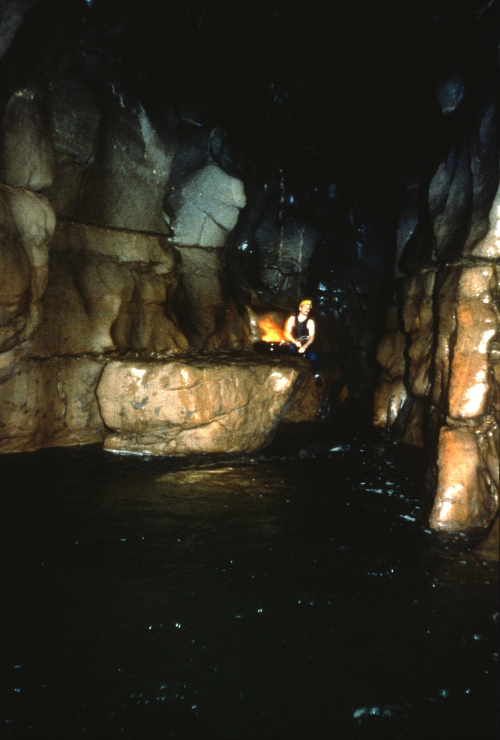
Notes:
After a few more ledges and swims...

Slide 54
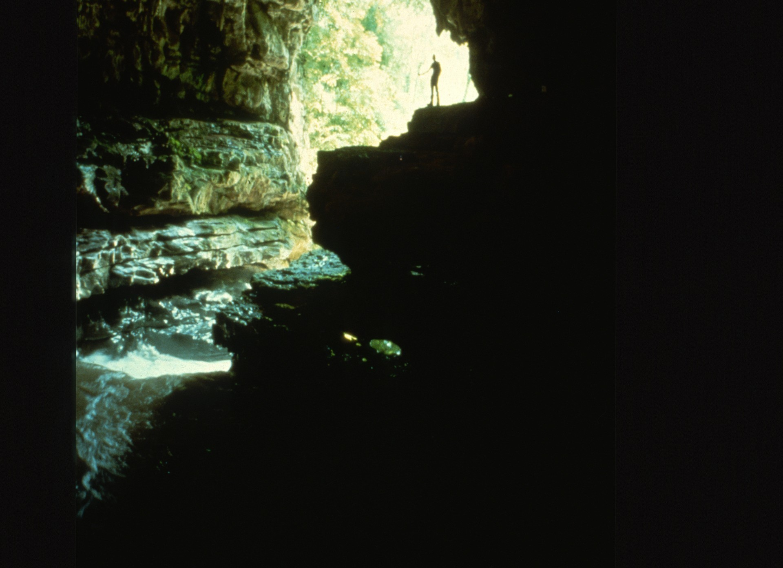
Notes:
…the lower entrance came into view ...

Slide 55
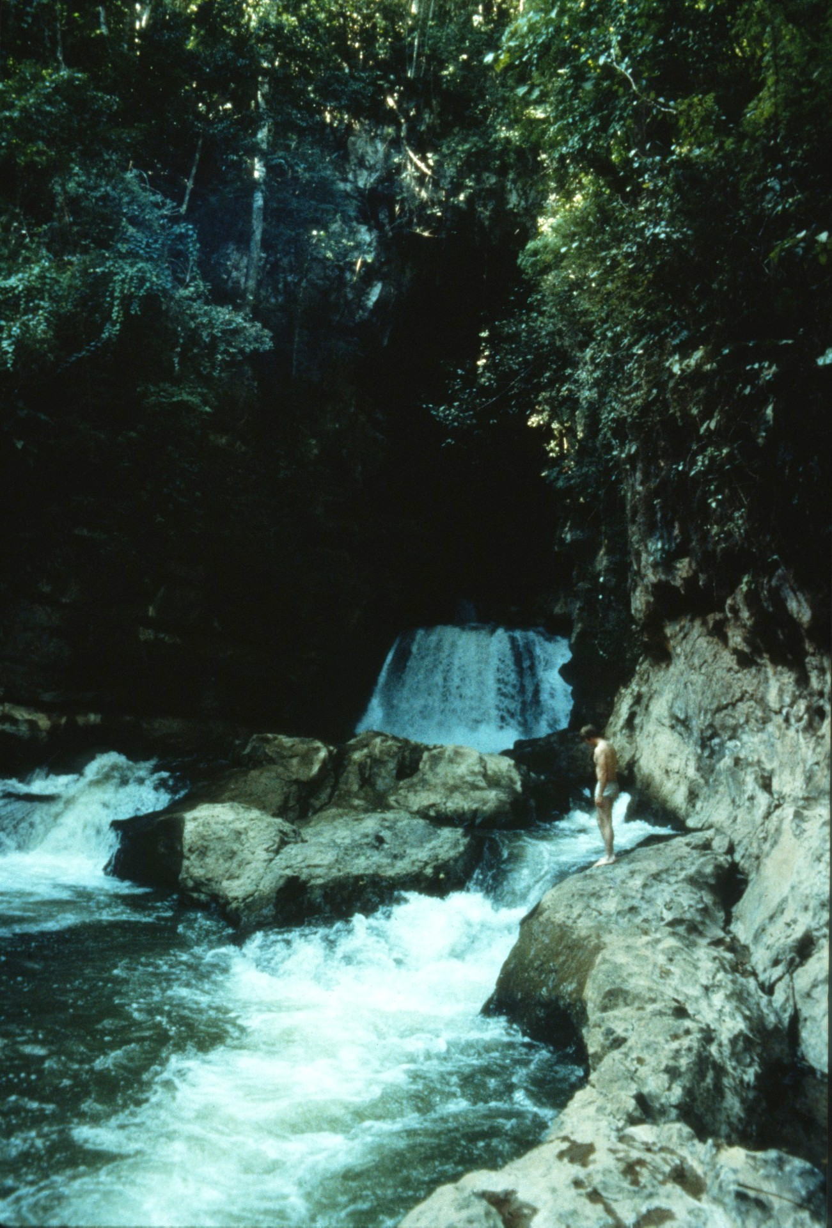
Notes:
…and finally they were outside.

Slide 56
Notes:
After de-rigging the cave, the 1987 expedition team posed for a final photograph. Steve Knutson was behind the camera.
This program was provided by the Audio/Visual Library of the National Speleological Society.The program’s slides were taken by Steve Knutson and other expedition members. Steve Knutson assembled the slides and wrote the first draft of the script. Paul Stevens produced the final script and the title slides. The program was completed in June 1989.

Slide 57
An NSS Audio-Visual Library Presentation
Exploration of the Sumidero of the Rio San Jose Atima, Honduras
Original slide program S741
Slides digitized by David Caudle
Script transcribed by Alex Sproul
PowerPoint program created by Jim McConkey
70 slides, with script in presenter notes
PowerPoint created 2/10/2021
National Speleological Society
6001 Pulaski Pike
Huntsville, AL 35810-1122
256- 852-1300
nss@caves.org
https://caves.org/

